Slide 2
Cubbies Theme Song

Slide 3
Jesus Loves Me

Slide 5
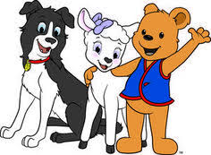
puppet
show

Slide 6
Lesson Time

Slide 26
Review
&
Memorize

Slide 27
Jesus loves Me

Slide 28
God loved us and sent His Son
1 John 4:10

Slide 29
…All have sinned…
Romans 3:23

Slide 30
…While we were still sinners,
Christ died for us.
Romans 5:8

Slide 31
“Where is the A?”
Where is the A?
Where is the A?
Here it is! Here it is!
Tell us what it stands for.
Tell us what it stands for.
A is for all … All have sinned …

Slide 32
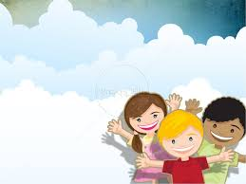
“Where is the C?”
Where is the C?
Where is the C?
Here it is!
Here it is!

Slide 33
Tell us what it stands for.
Tell us what it stands for.
C is for Christ.
C is for Christ.

Slide 34
Where is the C?
Where is the C?
Here it is!
Here it is!

Slide 35
Tell us what it stands for.
While we were still sinners,
Christ died for us.
Christ died for us.

Slide 36
