Slide 1


Slide 2

Cubbies Theme Song

Slide 3

He’s Got the Whole World in His Hands

Slide 4

My God is so Big

Slide 5
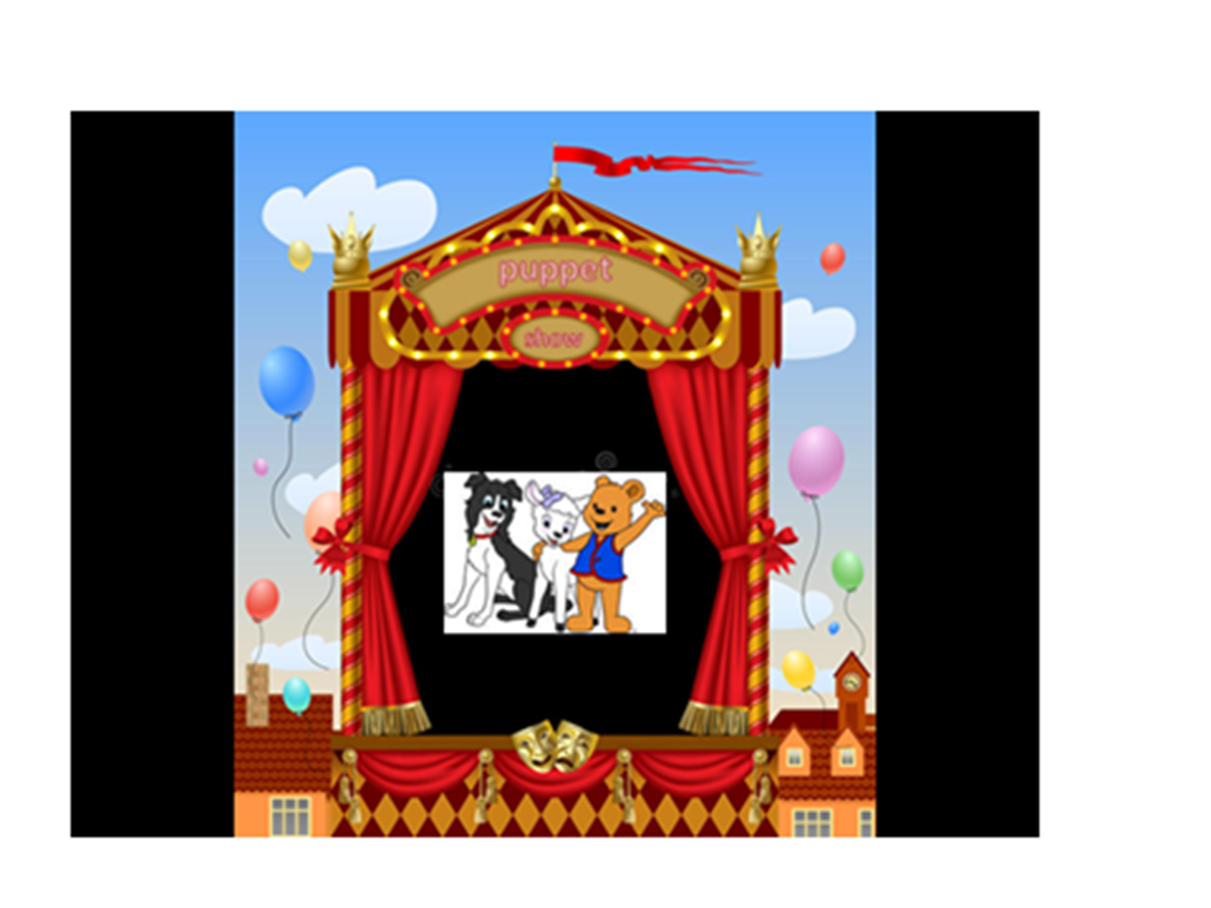

Slide 6


Slide 18


Slide 19


Slide 20

God saw all that He had made,
And it was very good…
Genesis 1:31

