Slide 1
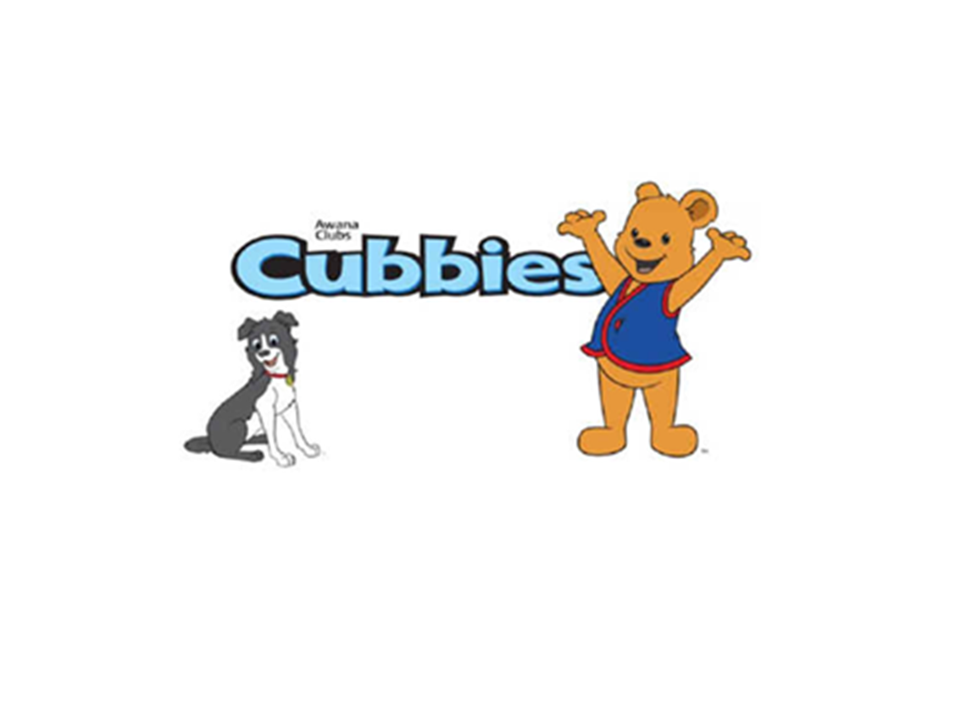

Slide 2

Cubbies Theme Song

Slide 3
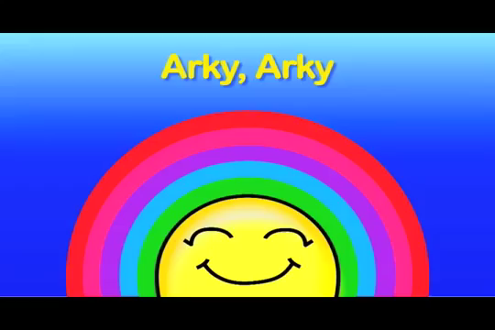
Arky, Arky

Slide 4
Mr. Noah Built an Ark (tune of “Old MacDonald Had a Farm.”

Slide 5
God Always Keeps His Promises

Slide 6
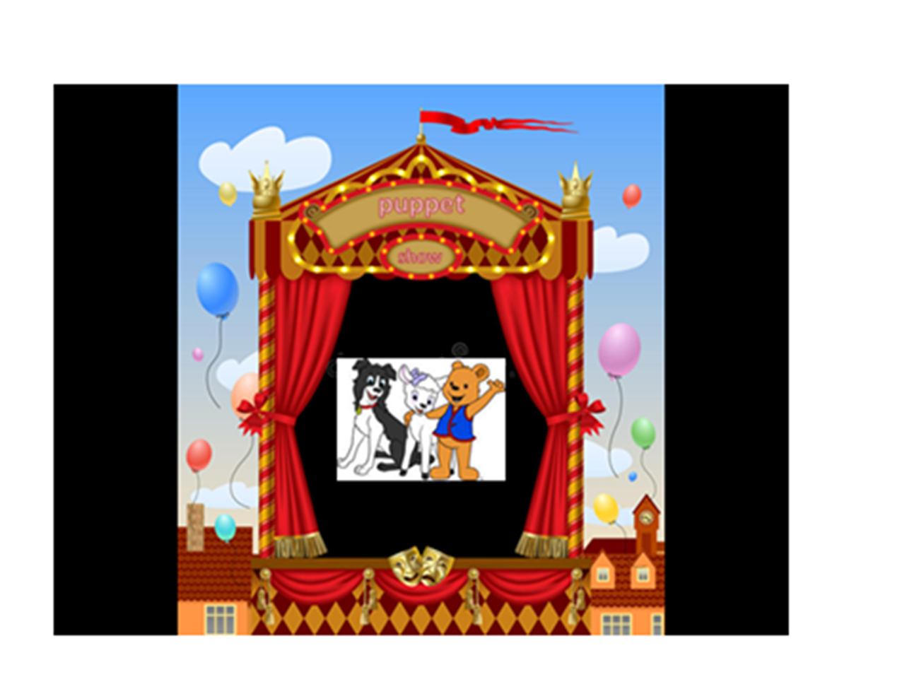

Slide 7
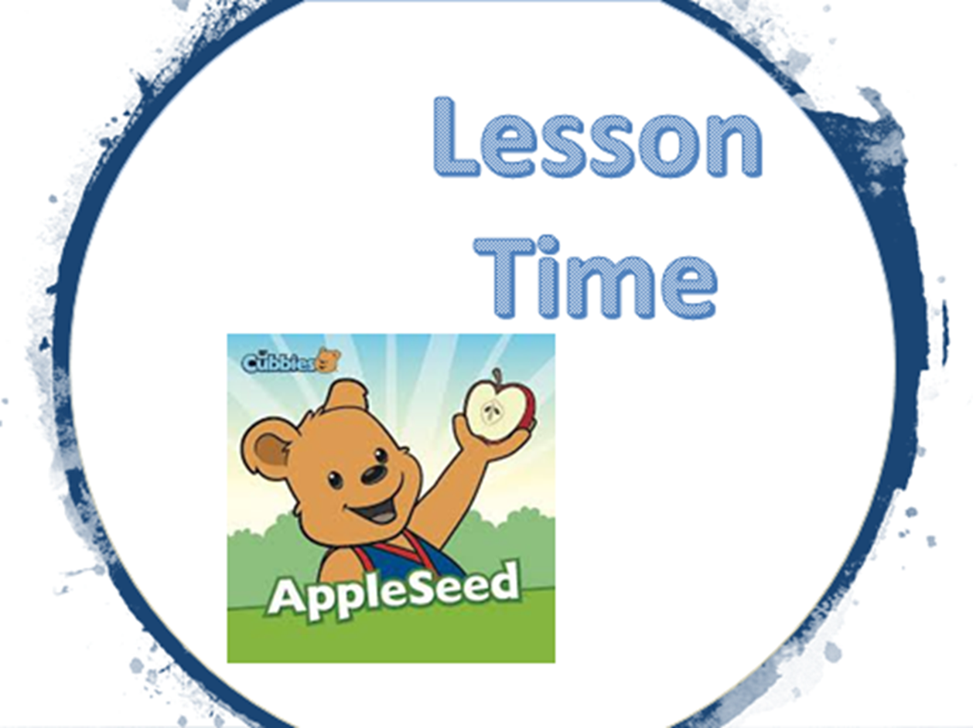

Slide 14
… Great is Your faithfulness.
Lamentations 3:23

Slide 15


Slide 16
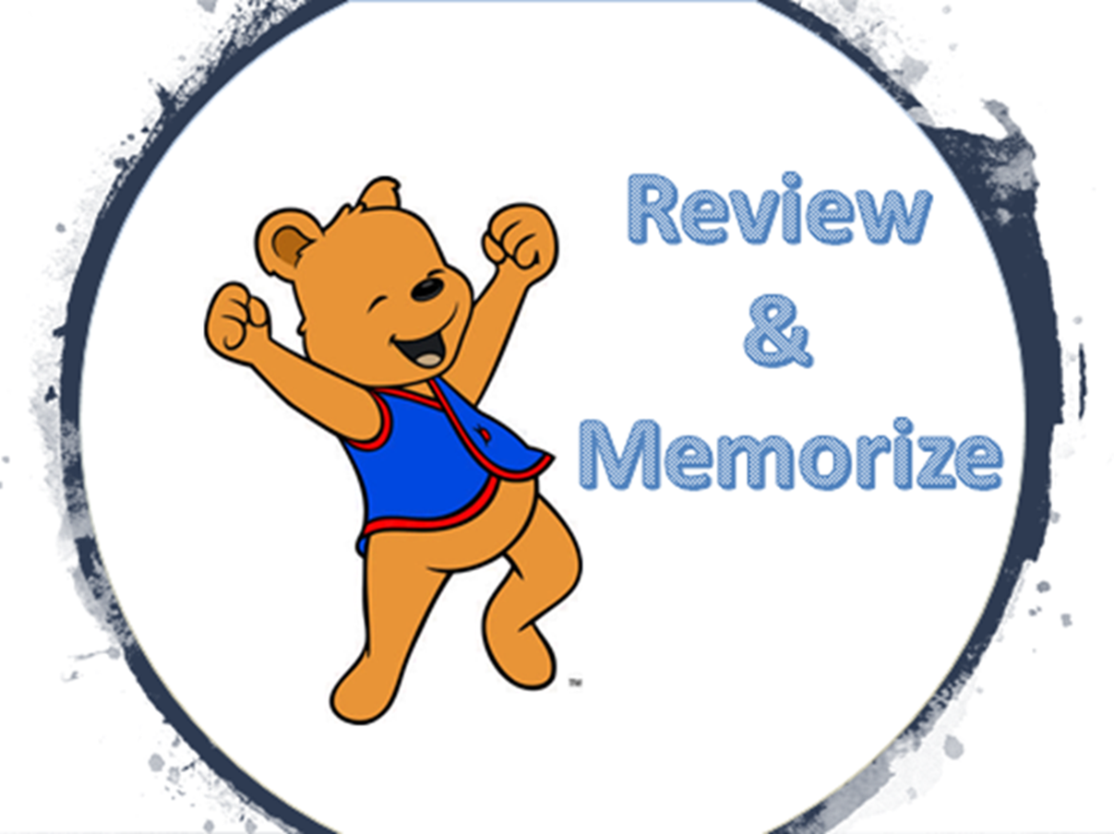

Slide 17
… Great is Your faithfulness.
Lamentations 3:23

