Slide 1
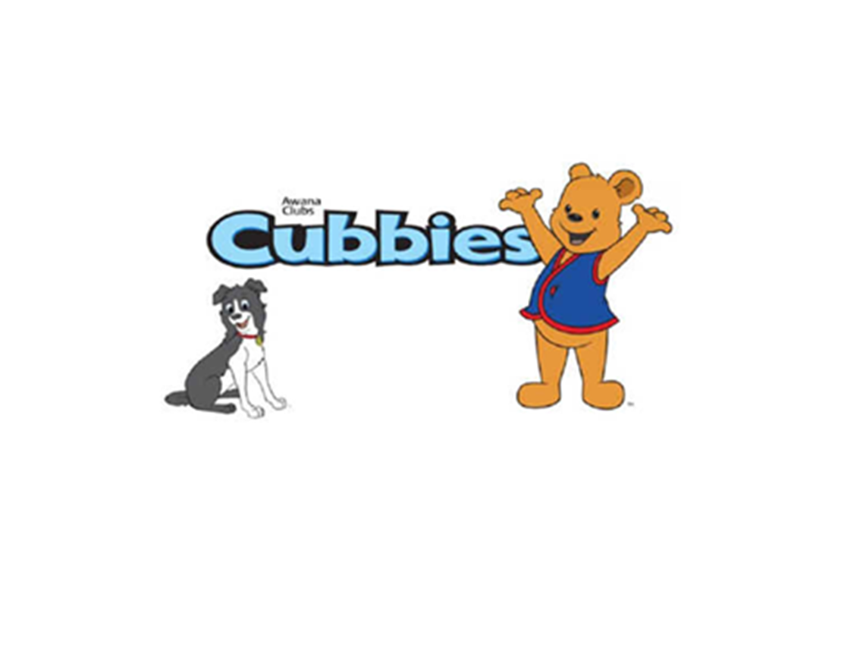

Slide 2

Cubbies Theme Song

Slide 3
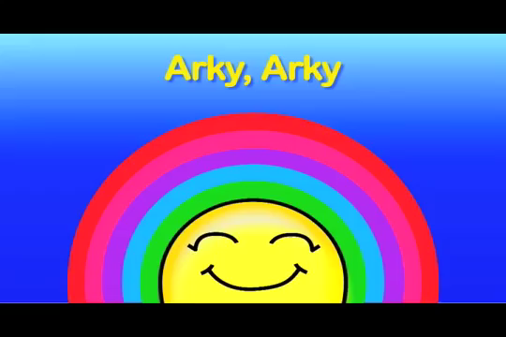
Arky, Arky

Slide 4
Mr. Noah Built an Ark (tune of “Old MacDonald Had a Farm.”

Slide 5
God Always Keeps His Promises

Slide 6
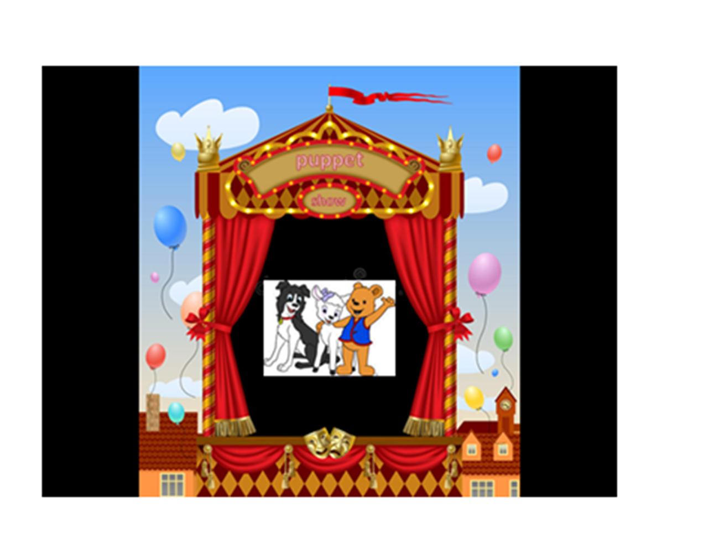

Slide 7
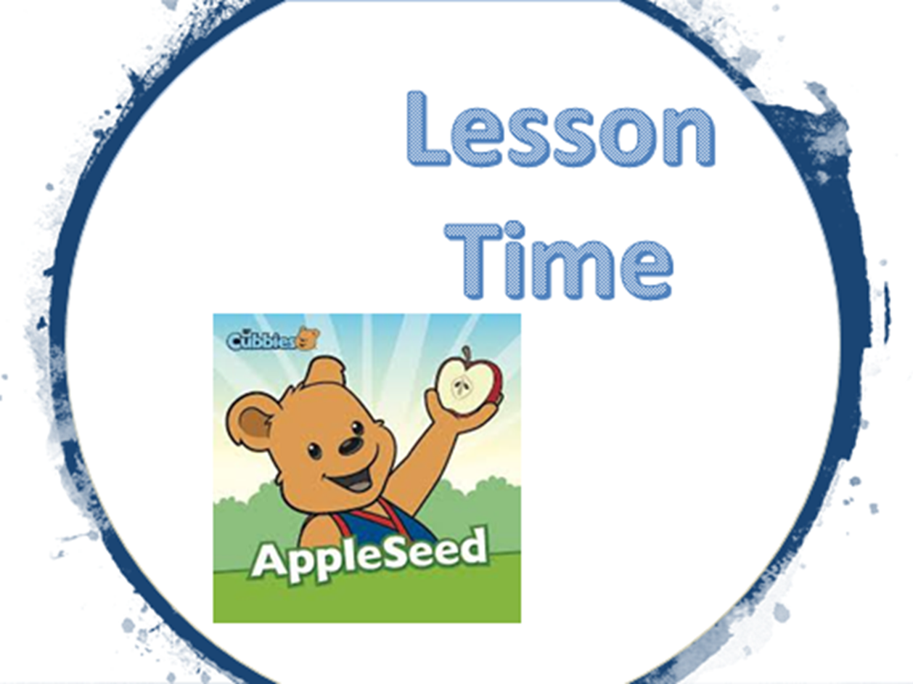

Slide 12
I will lie down
And sleep in peace
For You alone, O LORD,
Make me dwell in safety.
Psalm 4:8

Slide 13
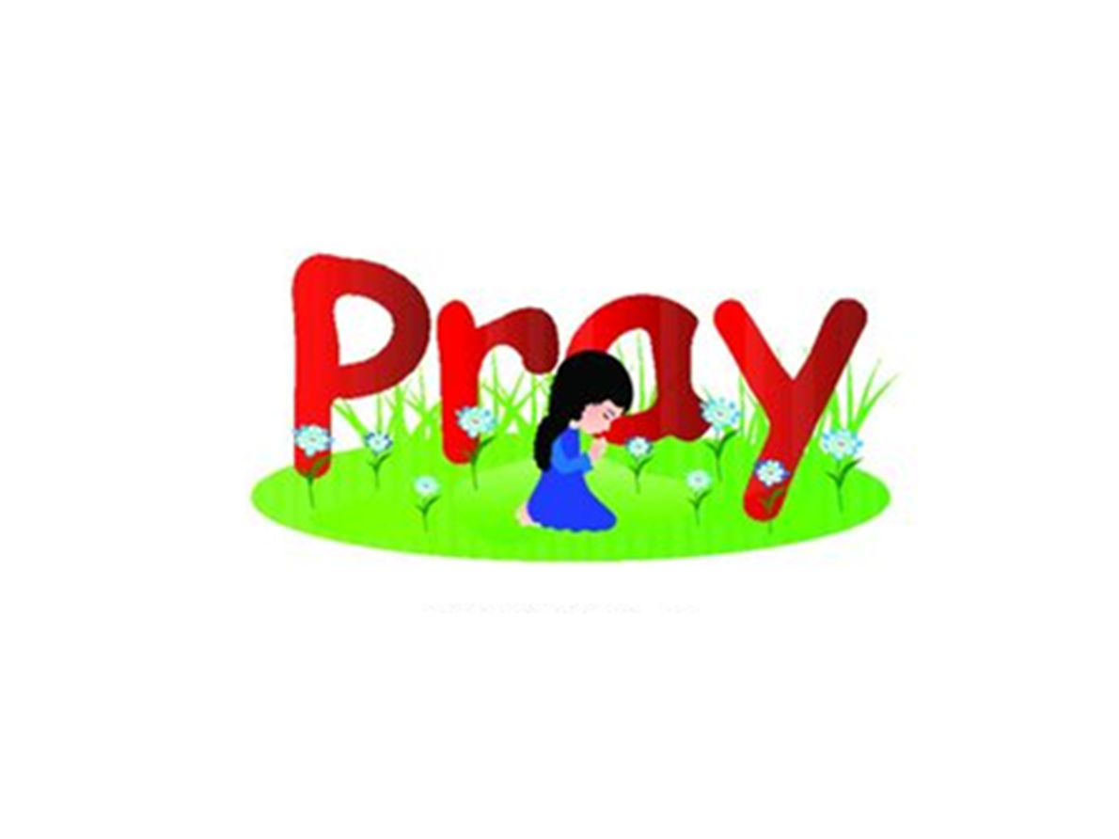

Slide 14
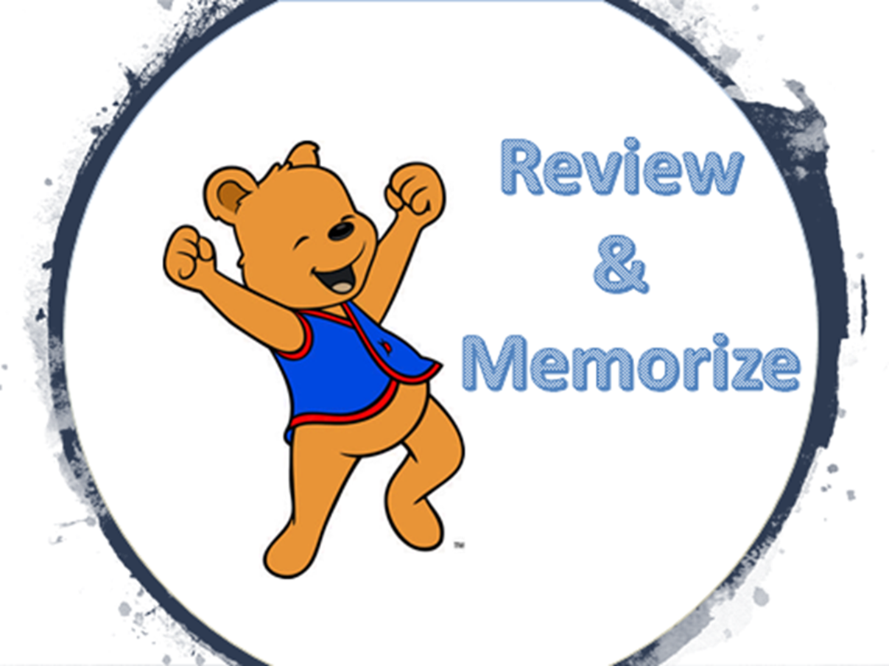

Slide 15
I will lie down
And sleep in peace
For You alone, O LORD,
Make me dwell in safety.
Psalm 4:8

