Slide 1
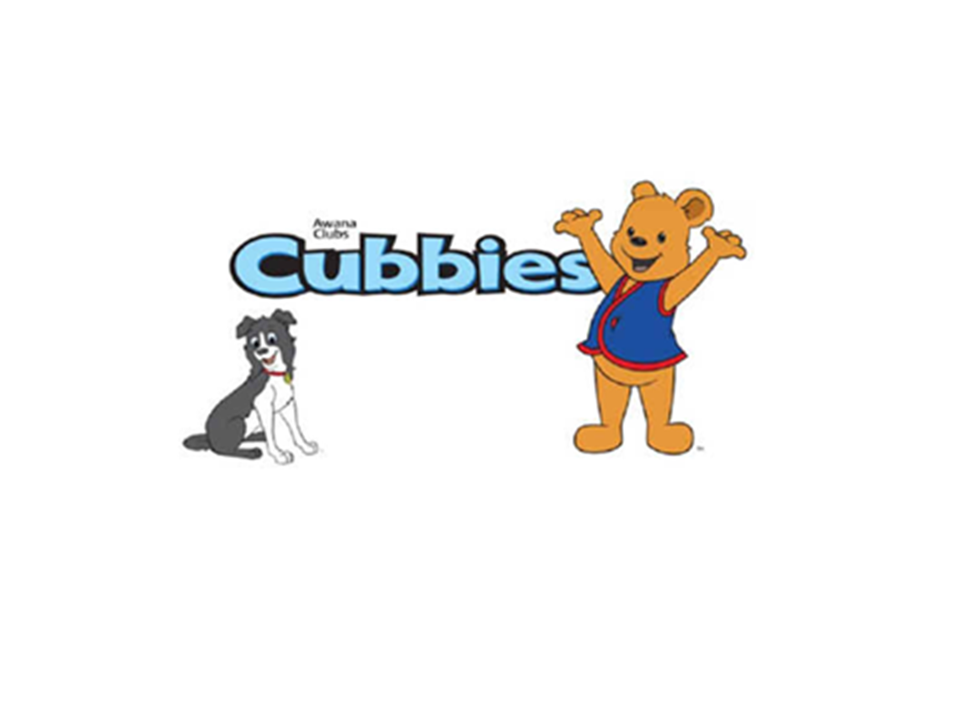

Slide 2

Cubbies Theme Song

Slide 3
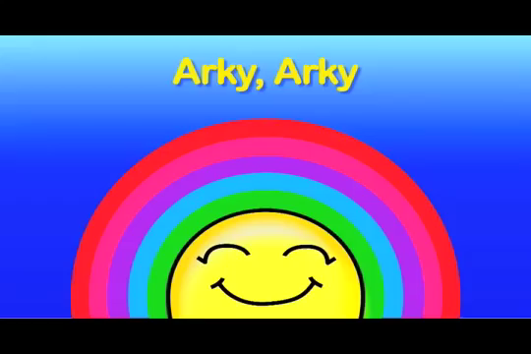
Arky, Arky

Slide 4
Mr. Noah Built an Ark (tune of “Old MacDonald Had a Farm.”

Slide 5
God Always Keeps His Promises

Slide 6
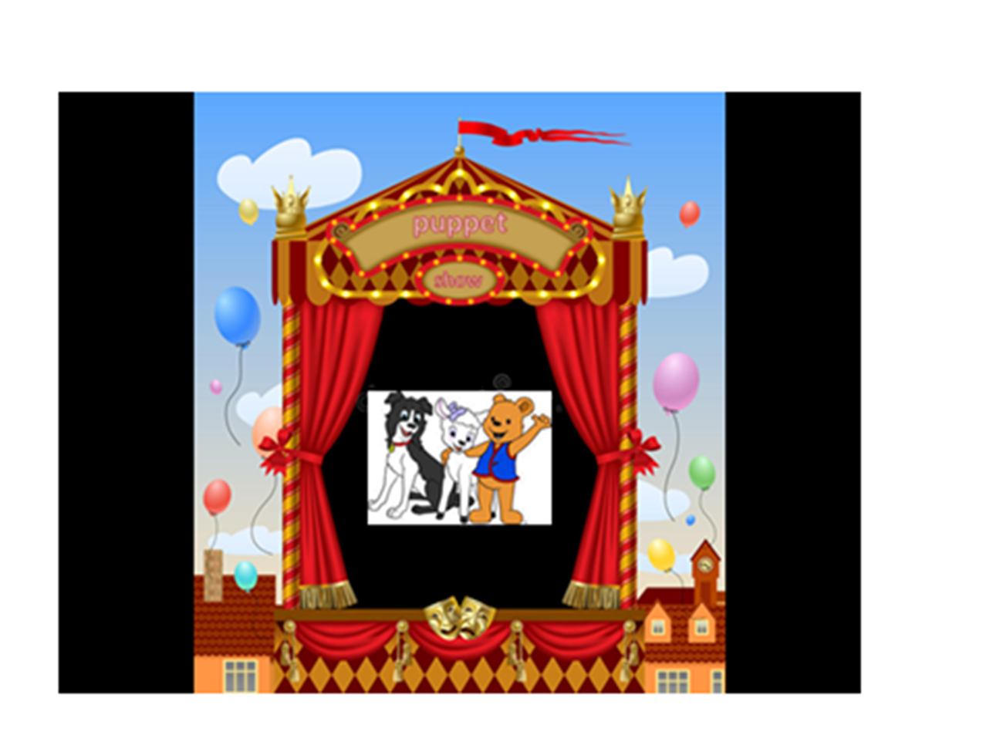

Slide 7
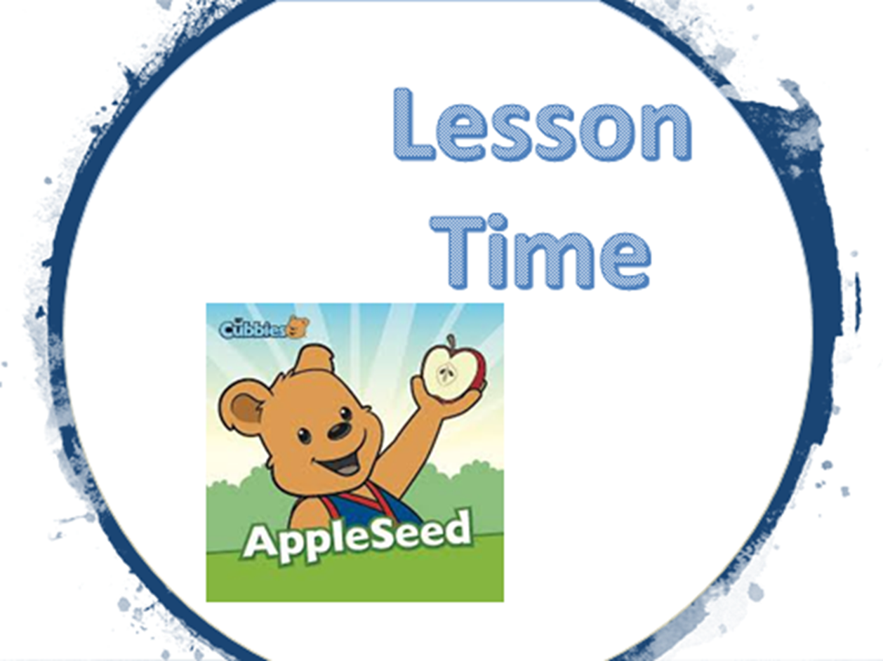

Slide 20


Slide 21


Slide 22
I [God] have set
My rainbow in the clouds,
And it will be the sign of the covenant
Between Me and the earth.
Genesis 9:13

