Slide 1


Slide 2

Cubbies Theme Song

Slide 3

My God is so Big

Slide 4


Slide 5
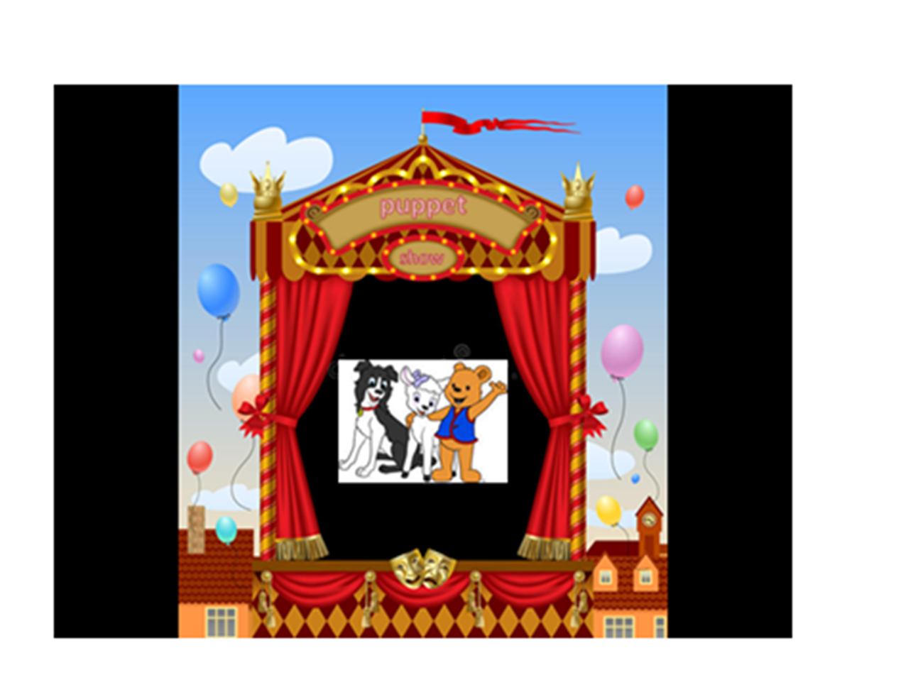

Slide 6
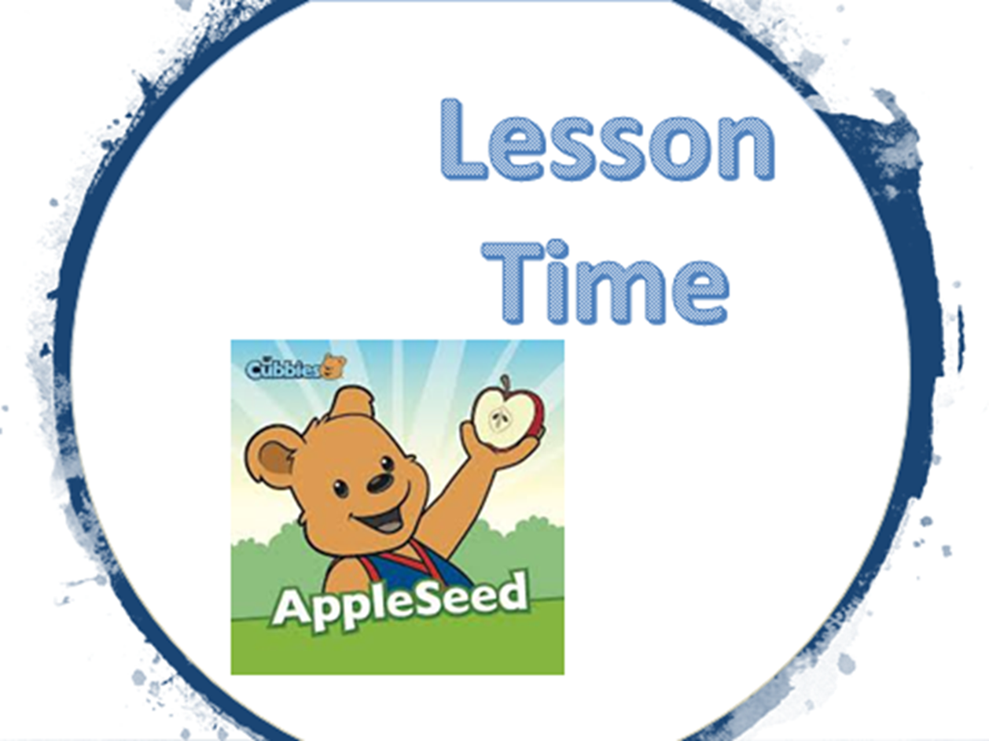

Slide 13
Great is our Lord
And mighty in power…
Psalm 147:5

Slide 14


Slide 15


Slide 16
Great is our Lord
And mighty in power…
Psalm 147:5

