Slide 1


Slide 2

Cubbies Theme Song

Slide 3
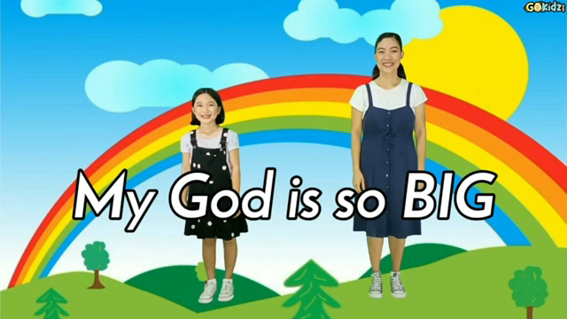
My God is so Big

Slide 4
Our God is an Awesome God

Slide 5
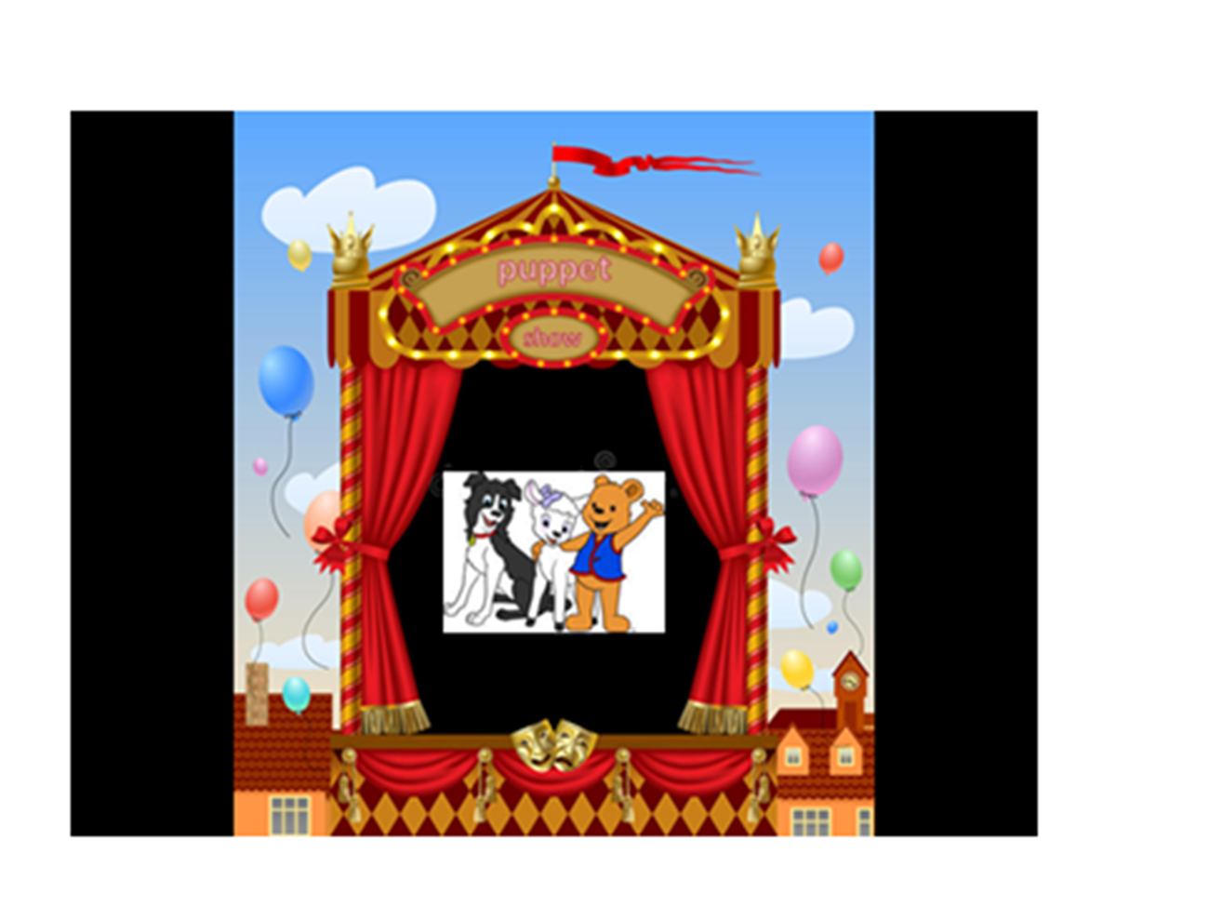

Slide 6


Slide 13
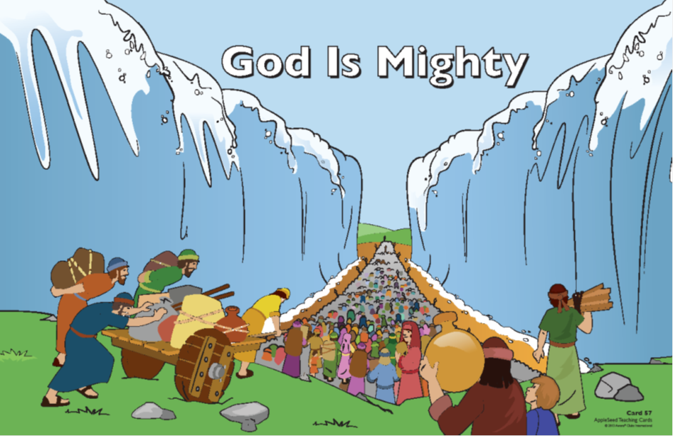
Our help is in the name of the Lord,
The Maker of heaven and earth.
Psalm 124:8

Slide 14


Slide 15


Slide 16
Our help is in the name of the Lord,
The Maker of heaven and earth.
Psalm 124:8

