Slide 1


Slide 2

Cubbies Theme Song

Slide 3
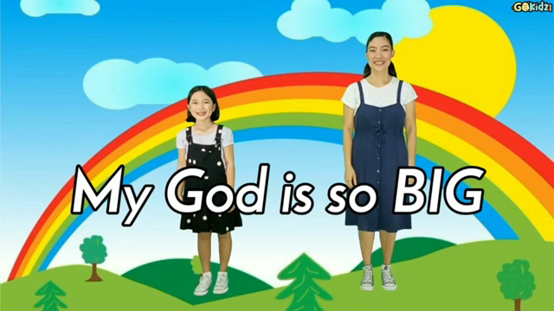
My God is so Big

Slide 4
Our God is an Awesome God

Slide 5
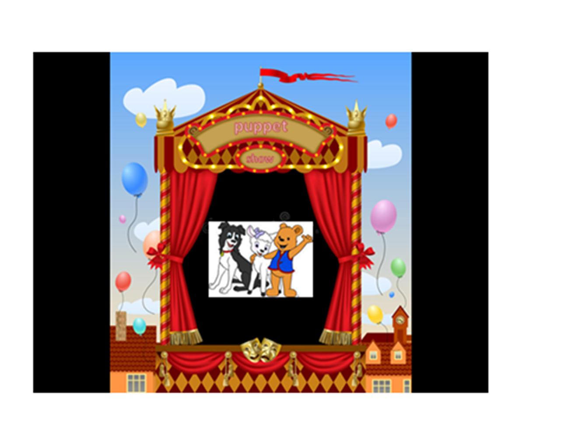

Slide 6


Slide 21
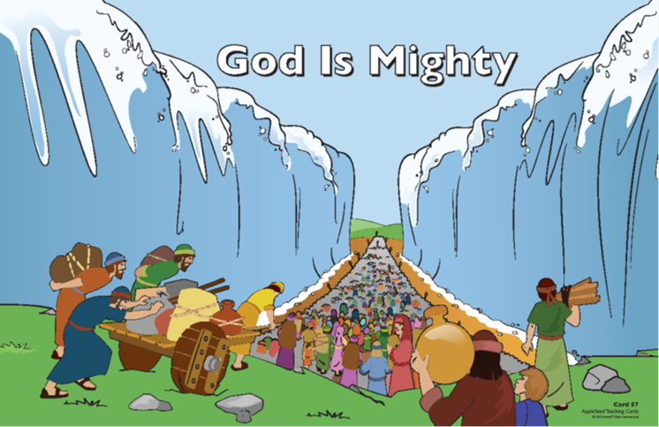
The LORD is my strength and my song;
He has become my salvation…
Exodus 15:2

Slide 22


Slide 23


Slide 24
The LORD is my strength and my song;
He has become my salvation…
Exodus 15:2

