Slide 1


Slide 2

Cubbies Theme Song

Slide 3
Our God is an Awesome God

Slide 4

Praise ye the Lord, Hallelujah

Slide 5
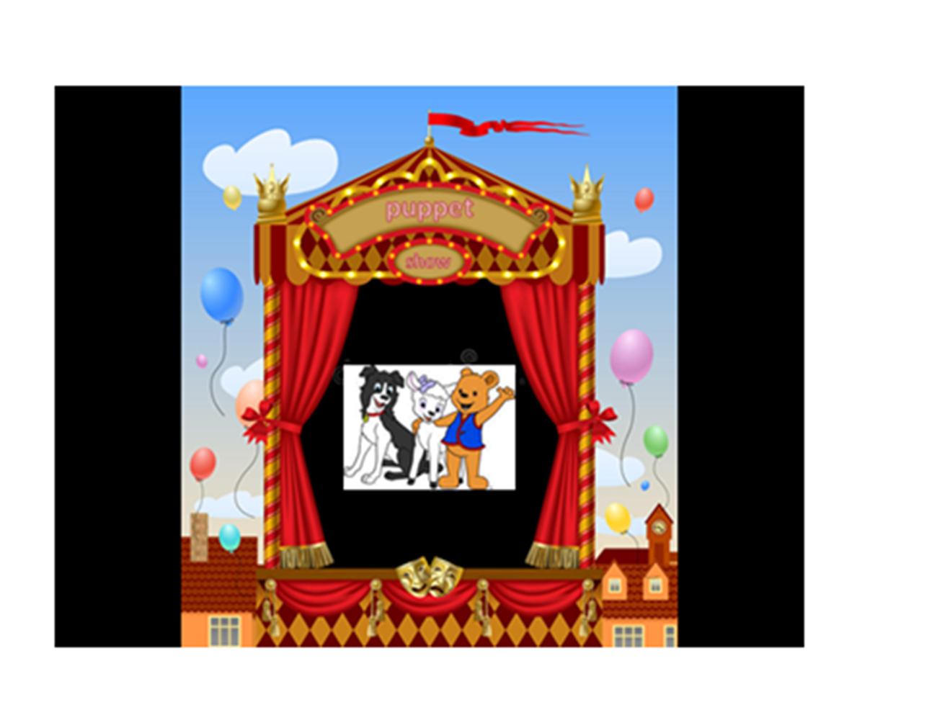

Slide 6
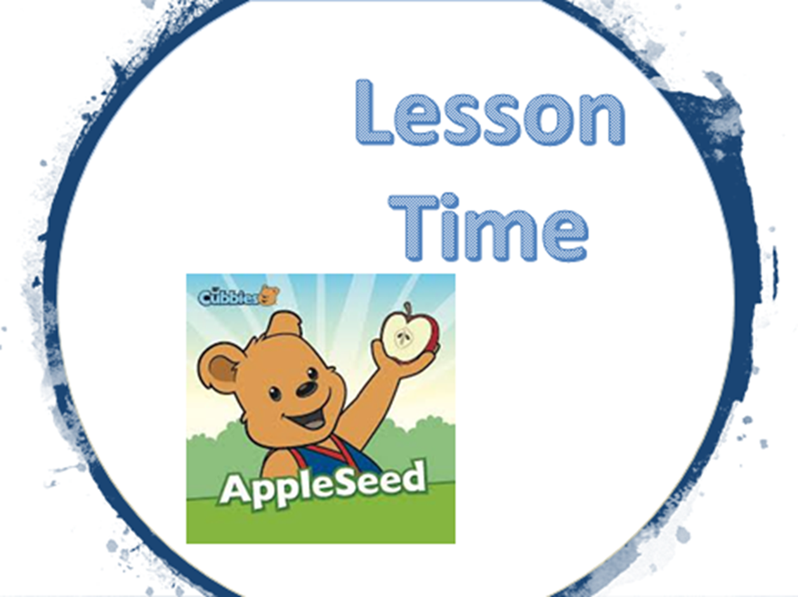

Slide 15


Slide 16


