Slide 1


Slide 2

Cubbies Theme Song

Slide 3
Our God is an Awesome God

Slide 4

Praise ye the Lord, Hallelujah

Slide 5
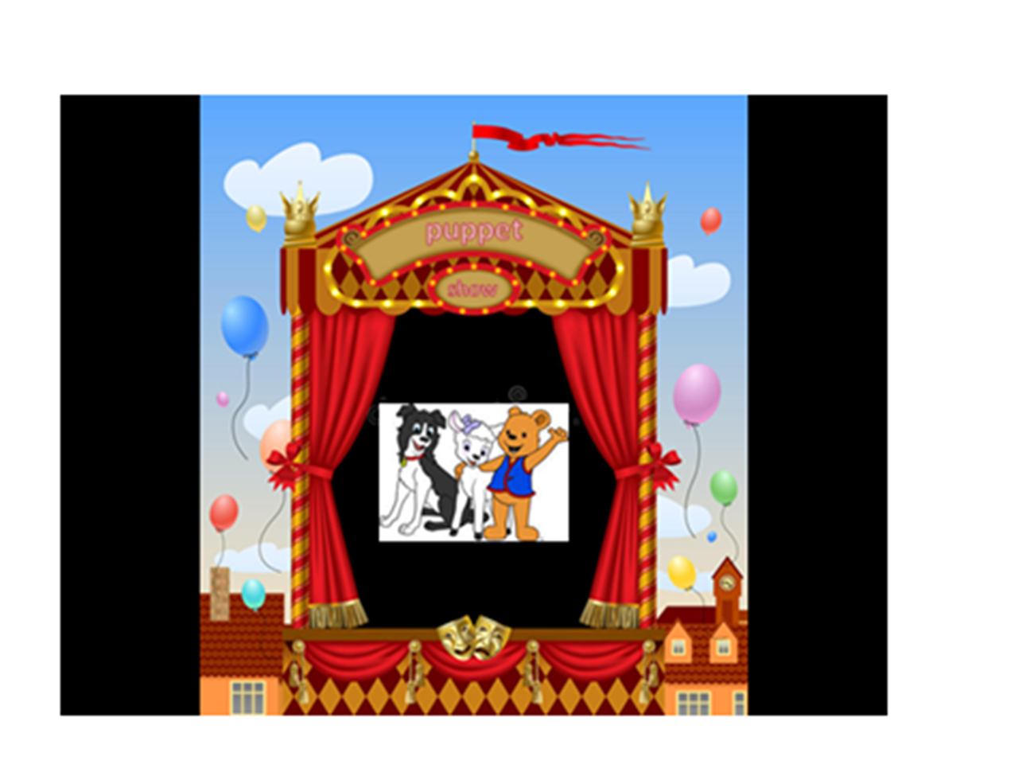

Slide 6
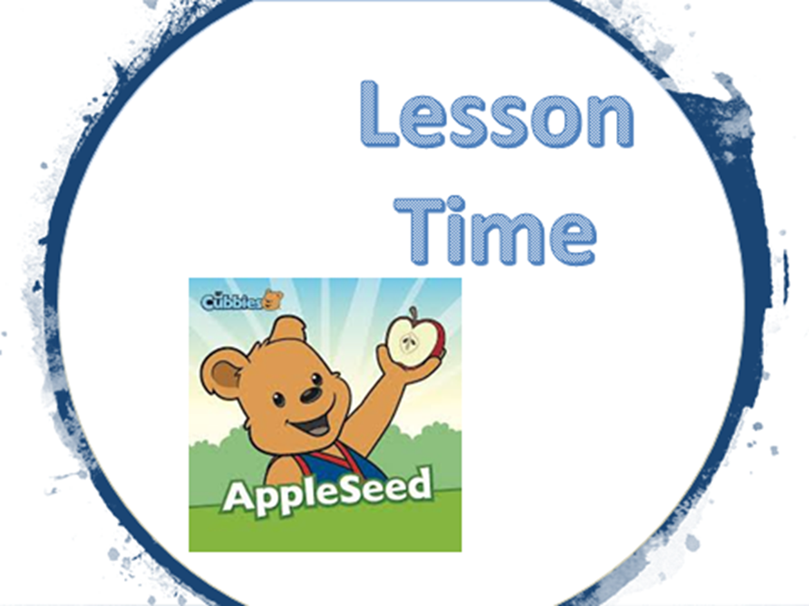

Slide 16
Love the Lord your God
With all your heart
And with all your soul
And with all your mind
And with all your strength.
Mark 12:30

Slide 17


Slide 18


Slide 19
Love the Lord your God
With all your heart
And with all your soul
And with all your mind
And with all your strength.
Mark 12:30

