Slide 1


Slide 2

Cubbies Theme Song

Slide 3
Our God is an Awesome God

Slide 4

Praise ye the Lord, Hallelujah

Slide 5
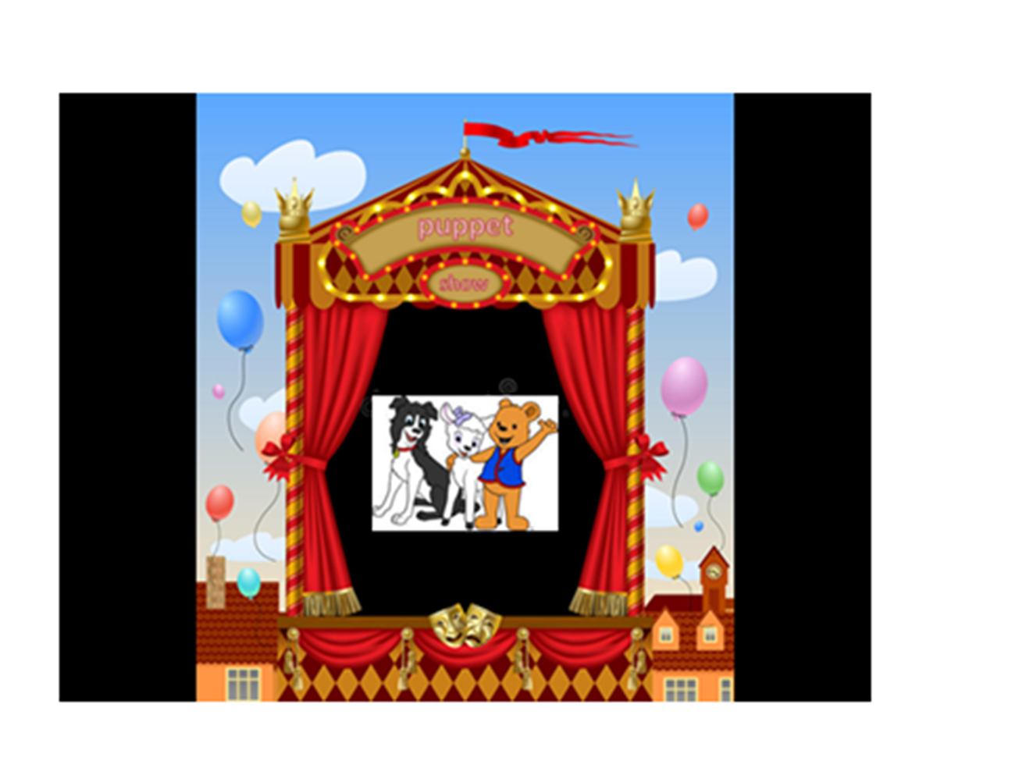

Slide 6
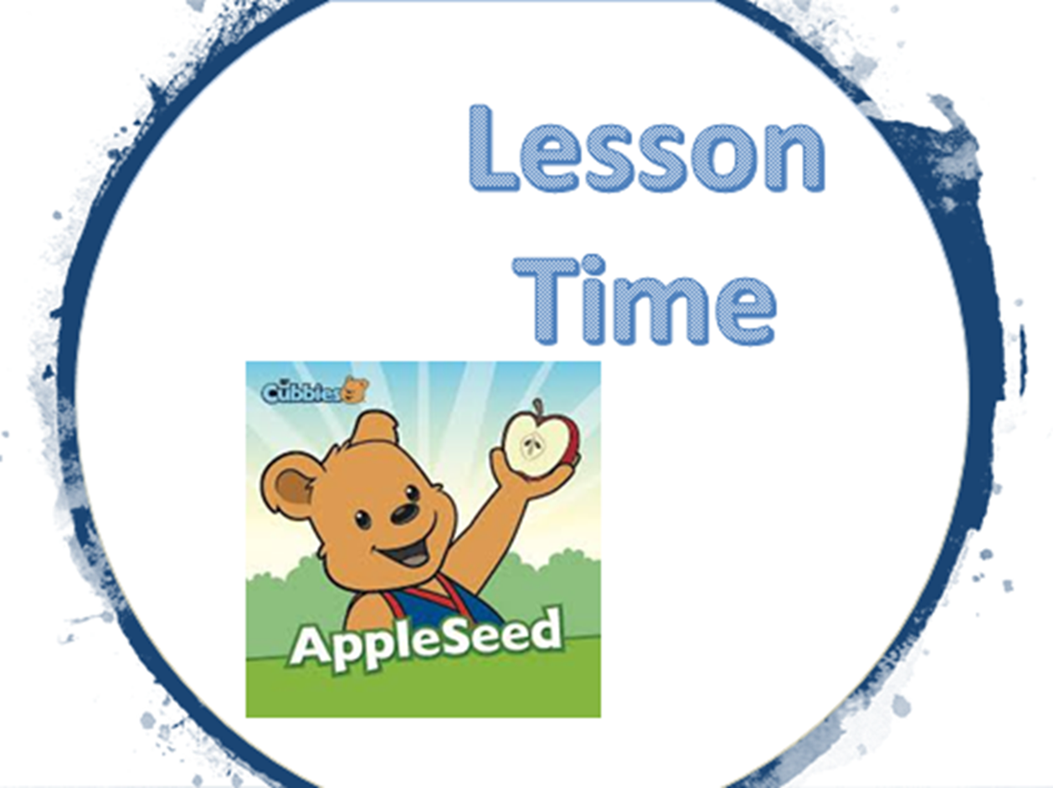

Slide 22
In God I trust;
I will not be afraid.
What can man do to me?
Psalm 56:11

Slide 23


Slide 24


Slide 25
In God I trust;
I will not be afraid.
What can man do to me?
Psalm 56:11

