Slide 1


Slide 2

Cubbies Theme Song

Slide 3

Oh, Be Careful

Slide 4

Love the Lord

Slide 5
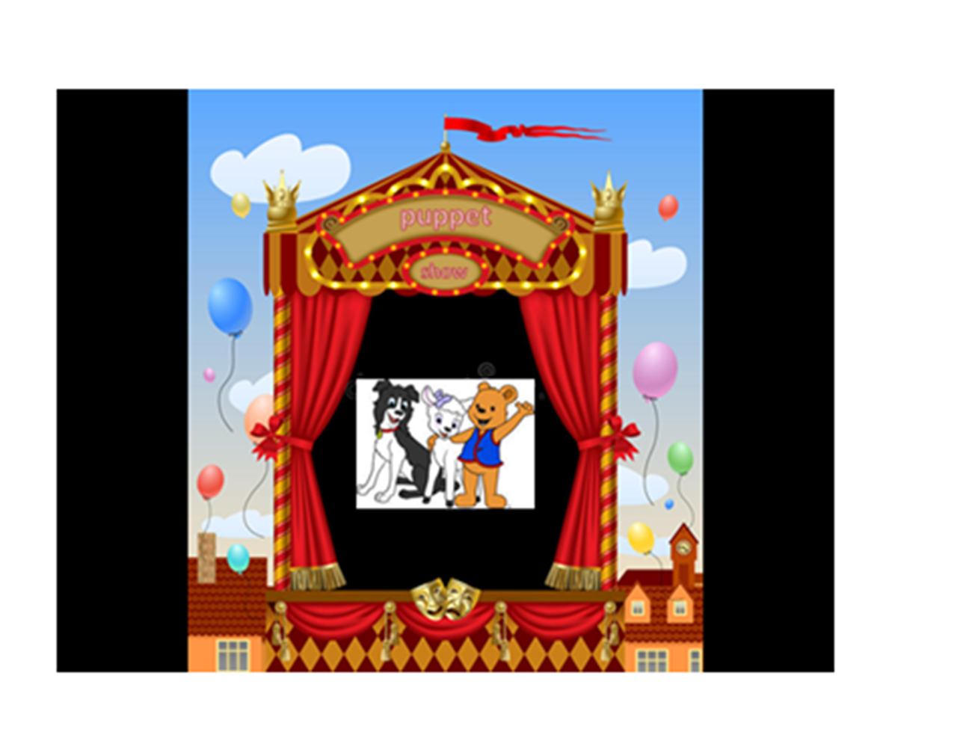

Slide 6


Slide 15
… “Look, the Lamb of God,
Who takes away the sin
Of the world!”
John 1:29

Slide 16


Slide 17


Slide 18
… “Look, the Lamb of God,
Who takes away the sin
Of the world!”
John 1:29

