Slide 1


Slide 2

Cubbies Theme Song

Slide 3
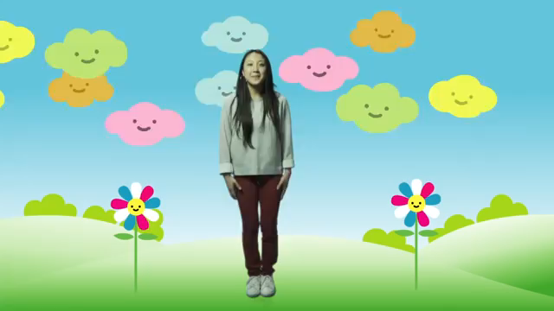
Love the Lord

Slide 4
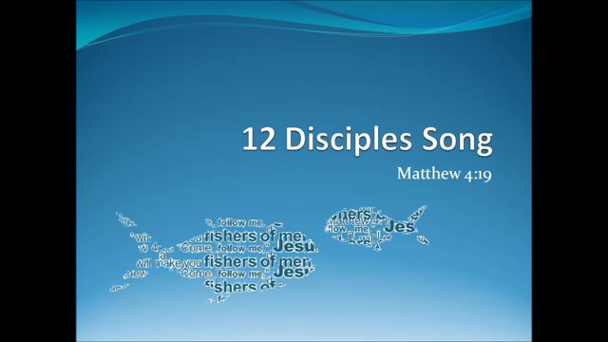
12 Disciples Song

Slide 5
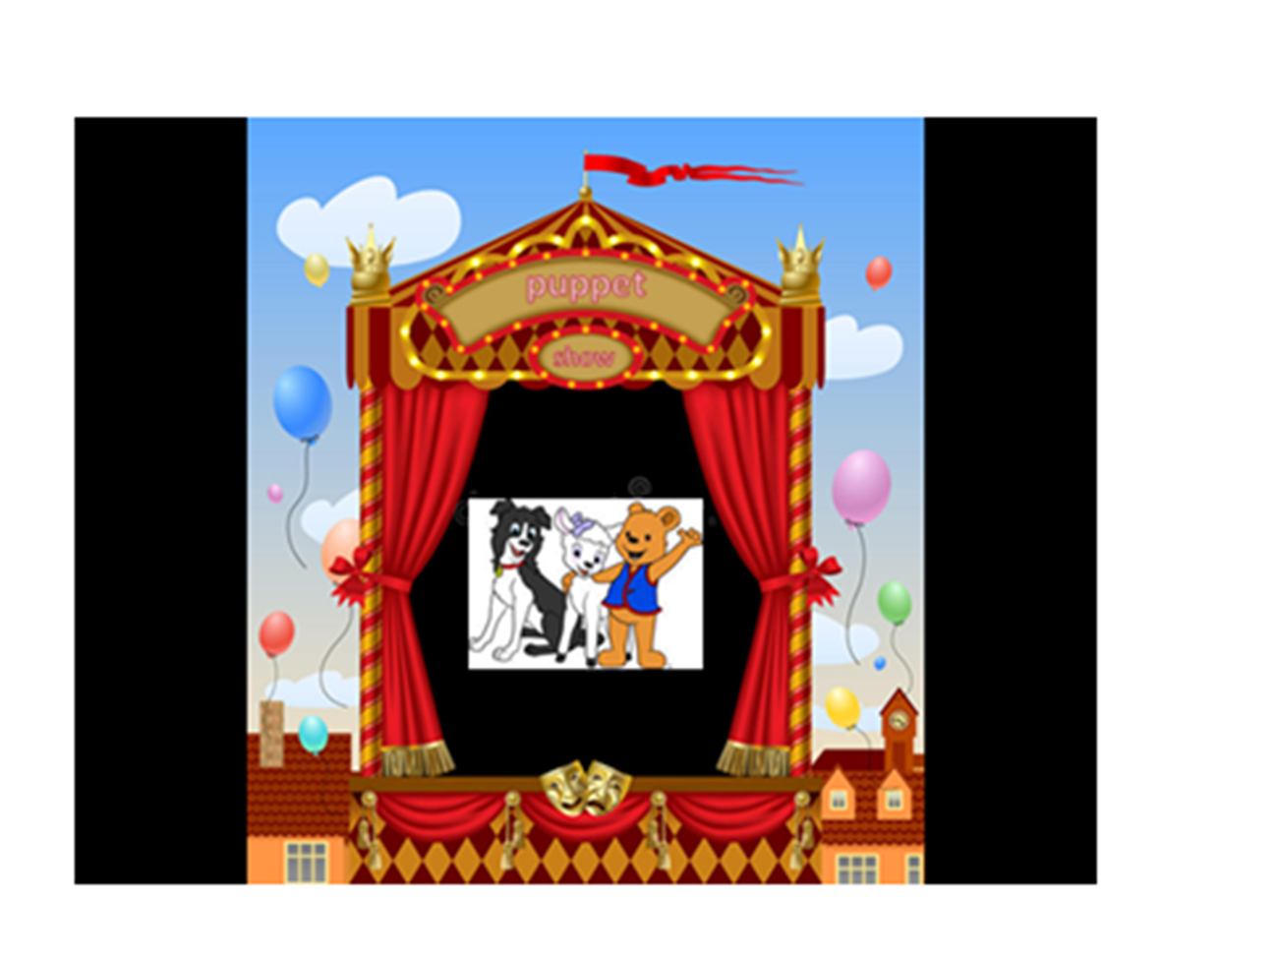

Slide 6


Slide 13
“Come, follow Me,” Jesus said,
“And I will make you fishers of men.”
Mark 1:17

Slide 14


Slide 15


Slide 16
“Come, follow Me,” Jesus said,
“And I will make you fishers of men.”
Mark 1:17

