Slide 1


Slide 2

Cubbies Theme Song

Slide 3

He’s Got the Whole World in His Hands

Slide 4
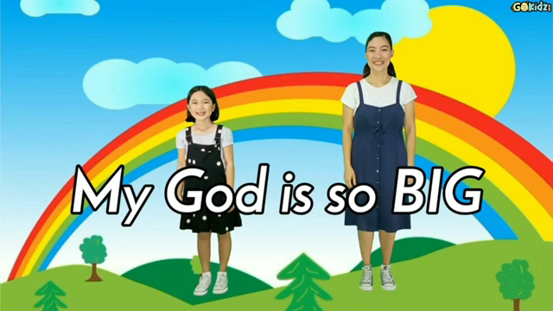
My God is so Big

Slide 5
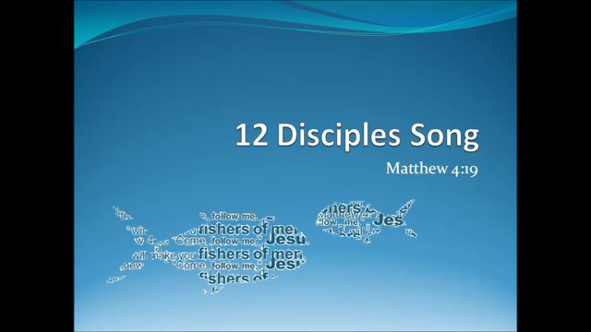
12 Disciples Song

Slide 6
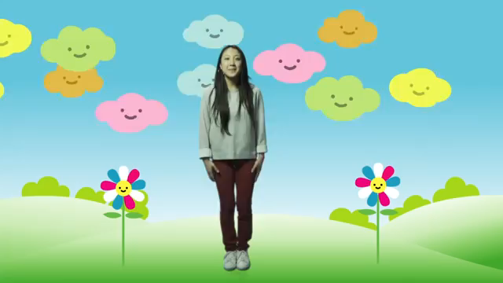
Love the Lord

Slide 7
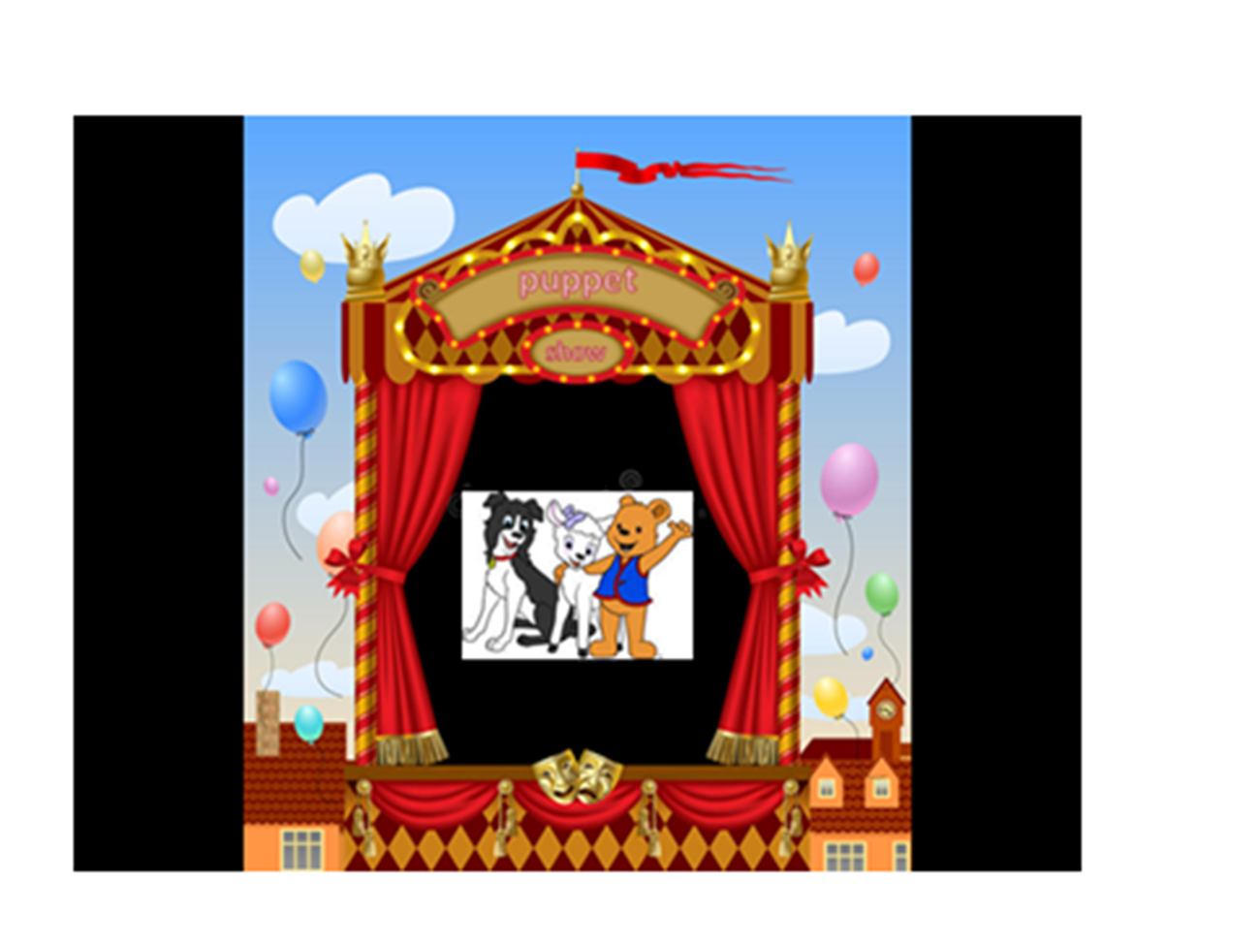

Slide 8


Slide 23
… “Who is this?
Even the wind and
The waves obey Him!”
Mark 4:41

Slide 24


Slide 25


Slide 26
… “Who is this?
Even the wind and
The waves obey Him!”
Mark 4:41

