Slide 1


Slide 2

Cubbies Theme Song

Slide 3
Joy to the World

Slide 4

Away in a Manger

Slide 5
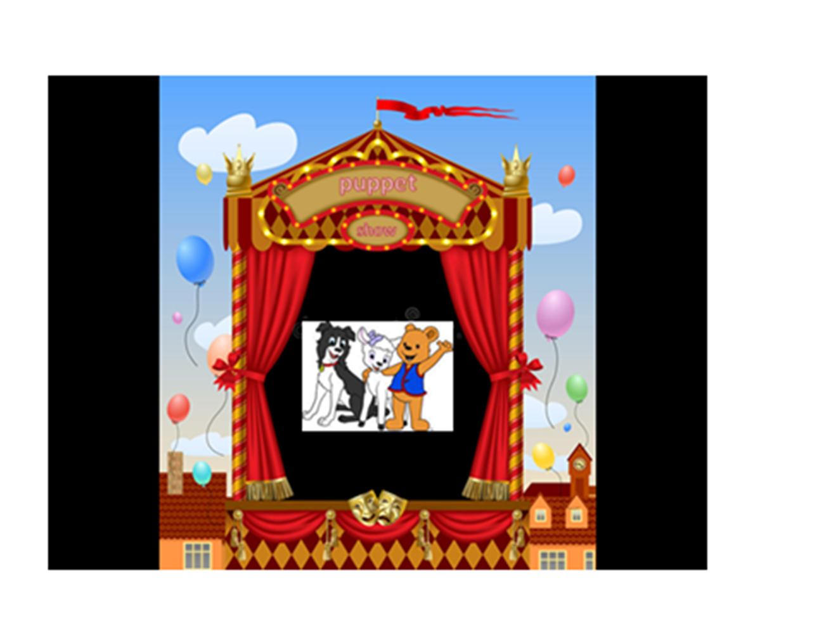

Slide 6


Slide 9
Today in the town of David
A Savior has been born to you;
He is Christ the Lord.
Luke 2:11

Slide 10


Slide 11


Slide 12
Today in the town of David
A Savior has been born to you;
He is Christ the Lord.
Luke 2:11

