Slide 1


Slide 2

Cubbies Theme Song

Slide 3

Jesus Loves Me

Slide 4

Jesus Loves the Little Children

Slide 5
Happy Day

Slide 6
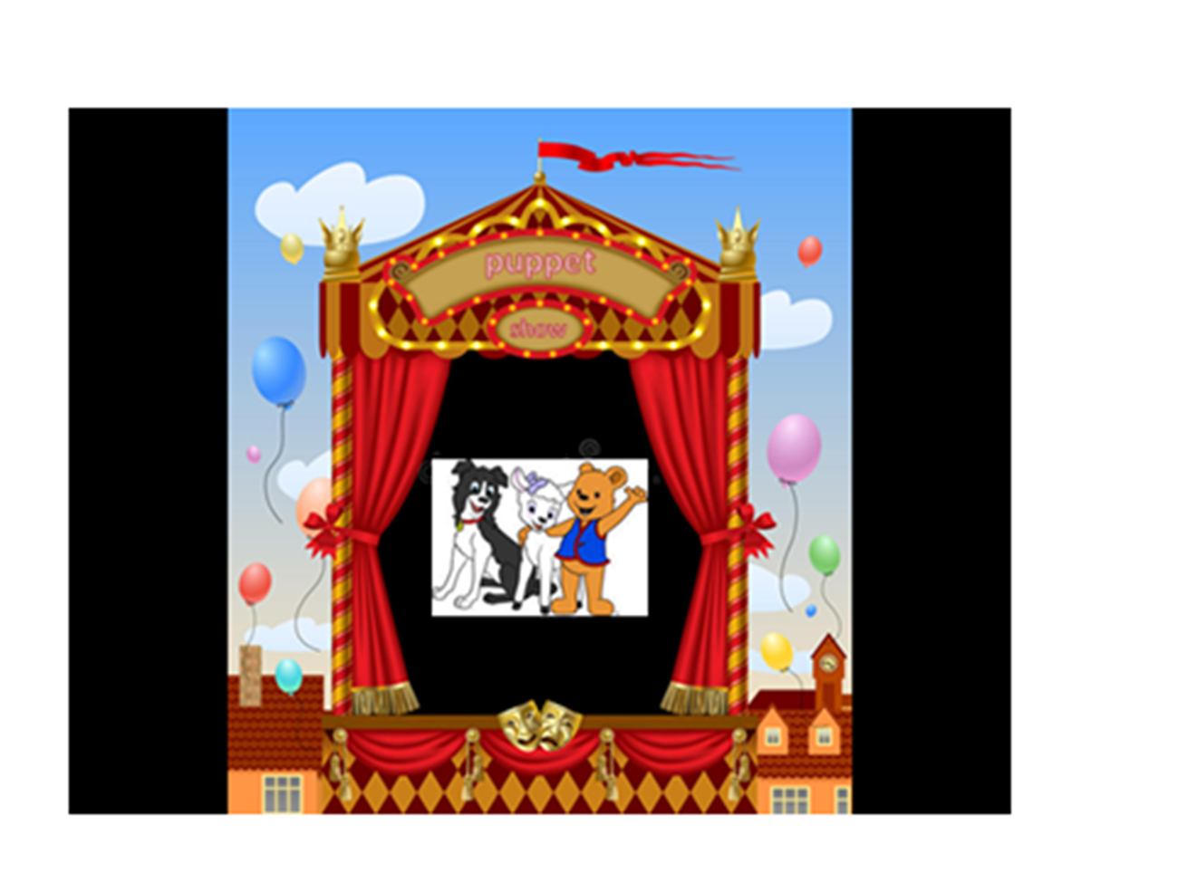

Slide 7


Slide 17
… He was raised on the third day
According to the Scriptures.
1 Corinthians 15:4

Slide 18


Slide 19


Slide 20
… He was raised on the third day
According to the Scriptures.
1 Corinthians 15:4

