Slide 1


Slide 2

Cubbies Theme Song

Slide 3

He’s Got the Whole World in His Hands

Slide 4

My God is so Big

Slide 5

All Things Bright and Beautiful

Slide 6
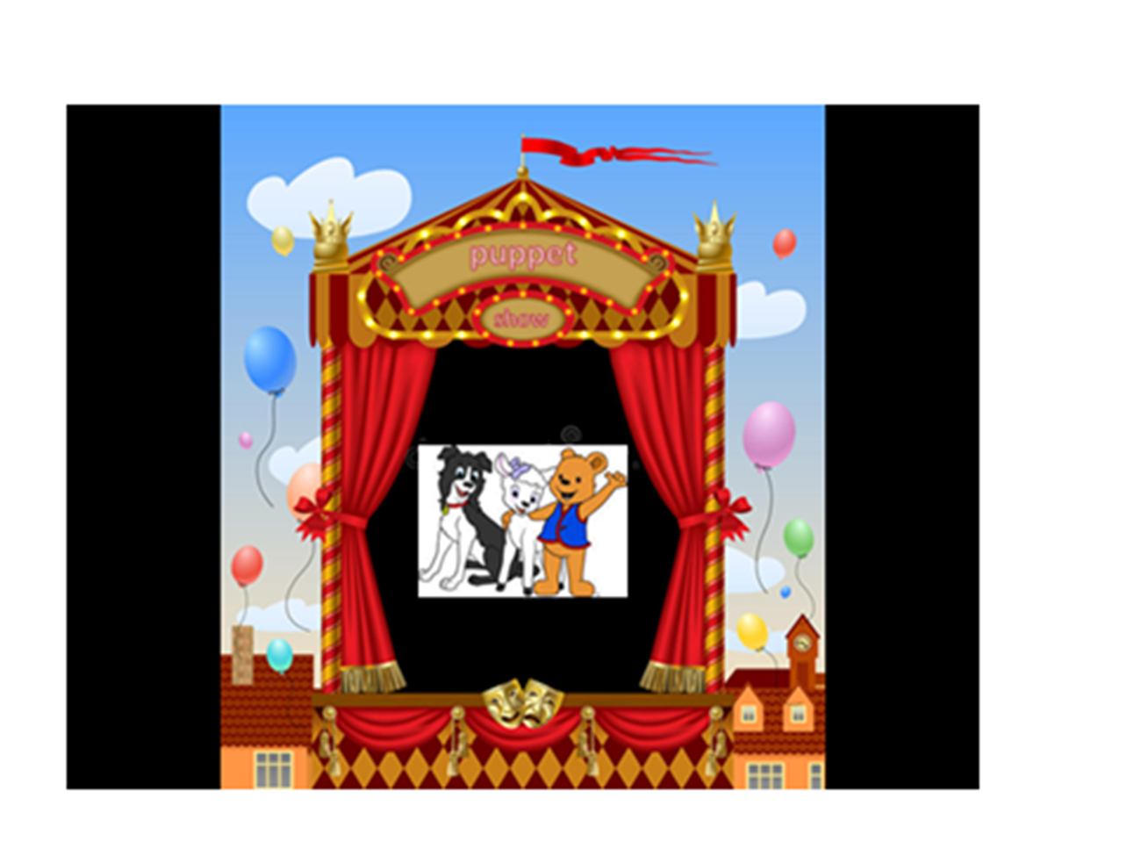

Slide 7
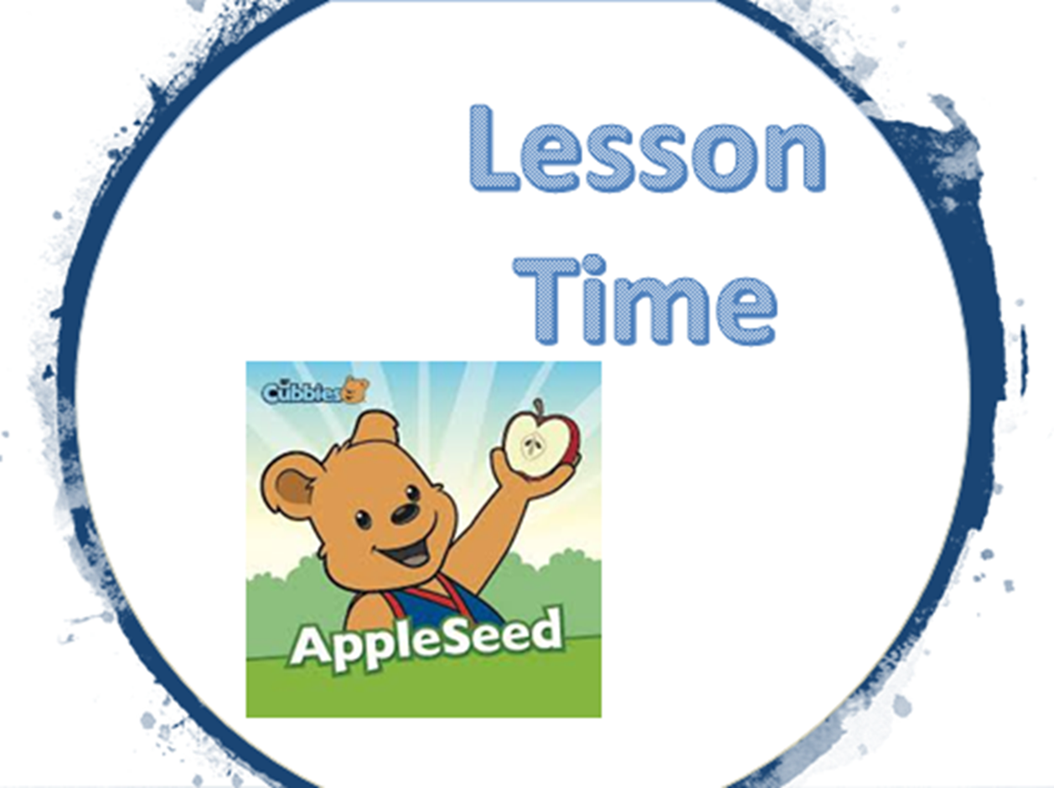

Slide 12


Slide 13


