Slide 1


Slide 2

Cubbies Theme Song

Slide 3
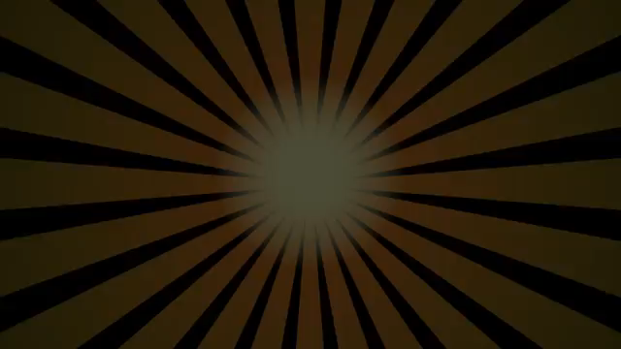
All Things Bright and Beautiful

Slide 4
Our God is an Awesome God

Slide 5
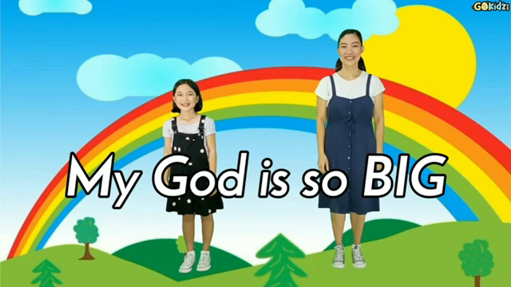
My God is so Big

Slide 6
God is So Good

Slide 7

Praise Him, Praise Him All the Little Children

Slide 8
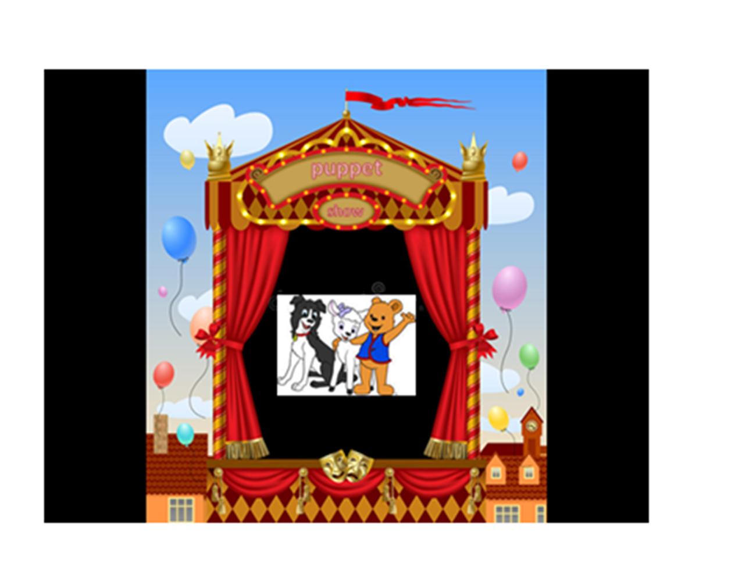

Slide 9


Slide 16


Slide 17


