Slide 1


Slide 2

Cubbies Theme Song

Slide 3
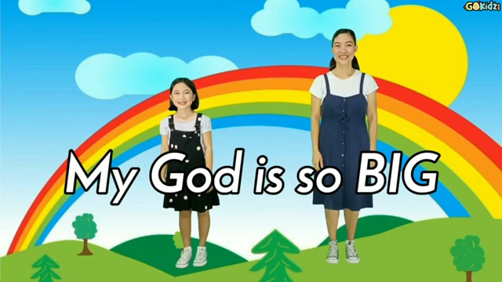
My God is so Big

Slide 4

Praise Him, Praise Him All the Little Children

Slide 5
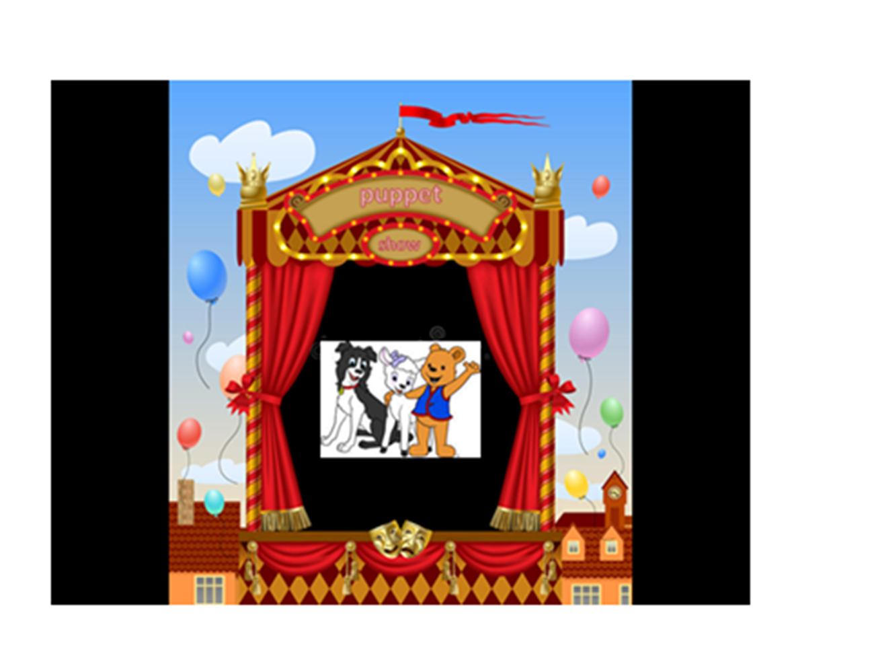

Slide 6
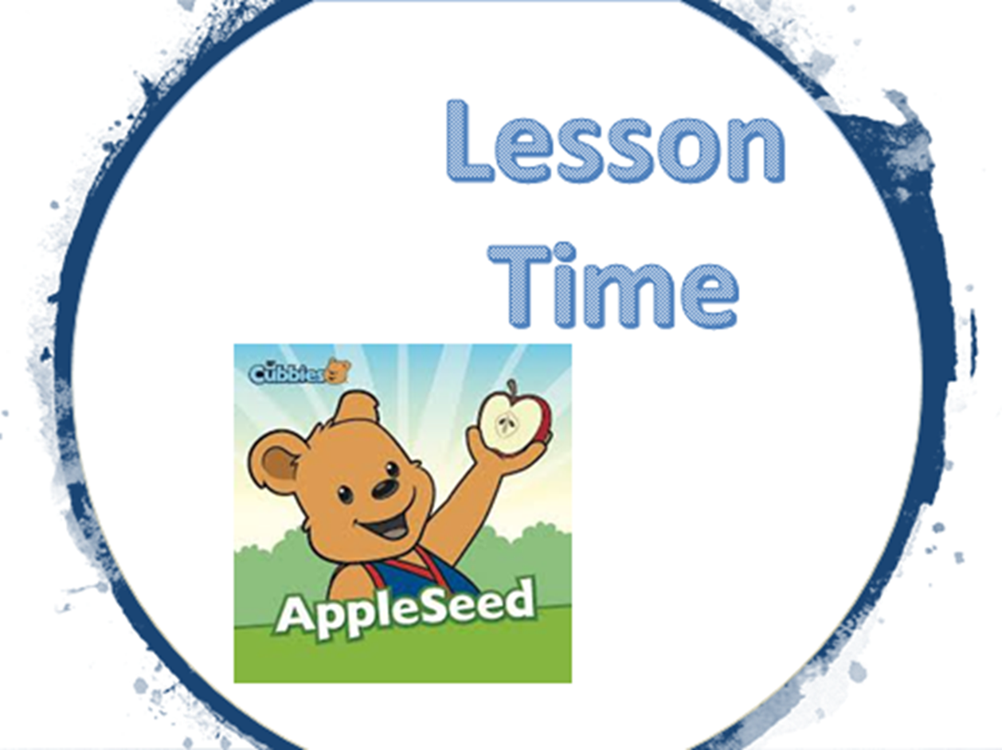

Slide 24


Slide 25


