Slide 1


Slide 2

Cubbies Theme Song

Slide 3

Jesus Loves Me

Slide 4

The B-I-B-L-E

Slide 5
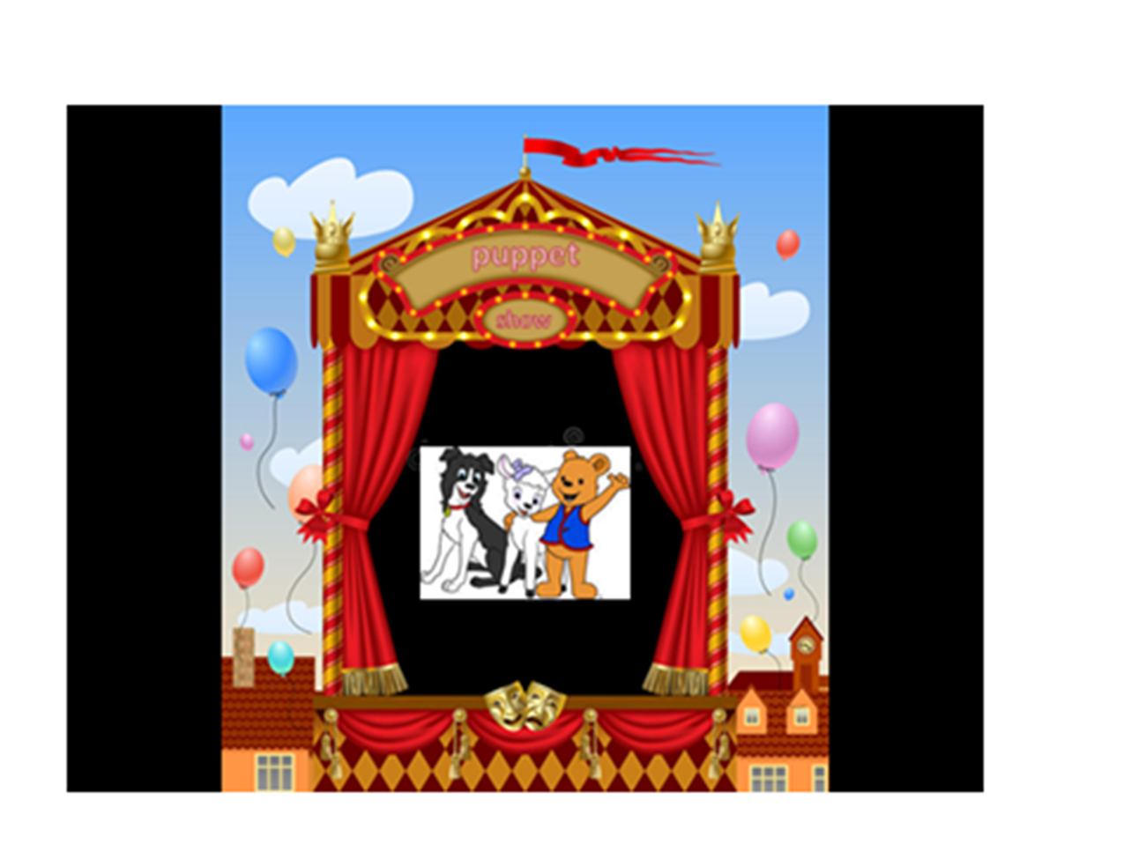

Slide 6
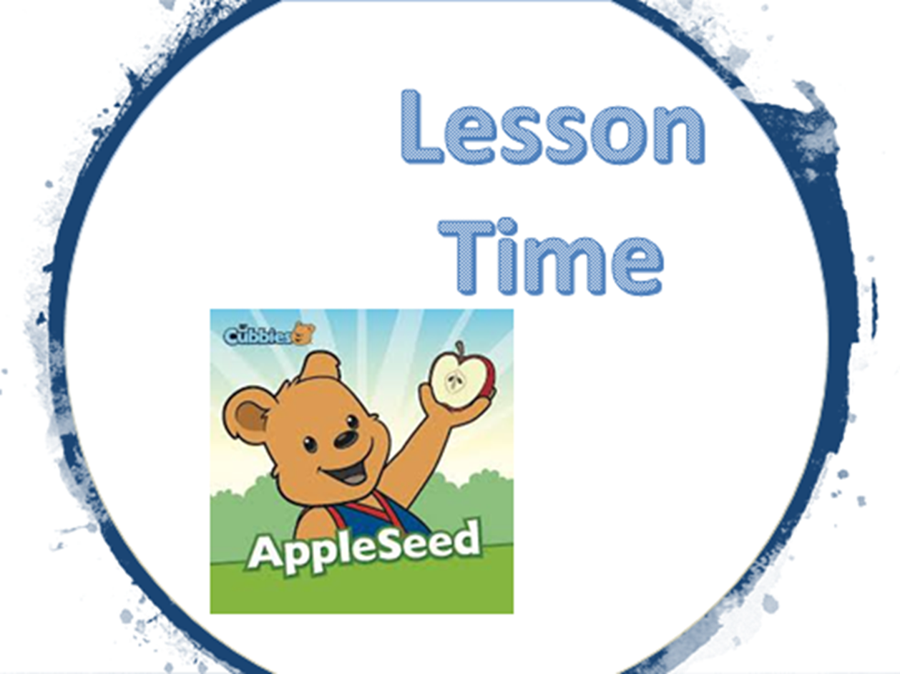

Slide 12


Slide 13
