Slide 1
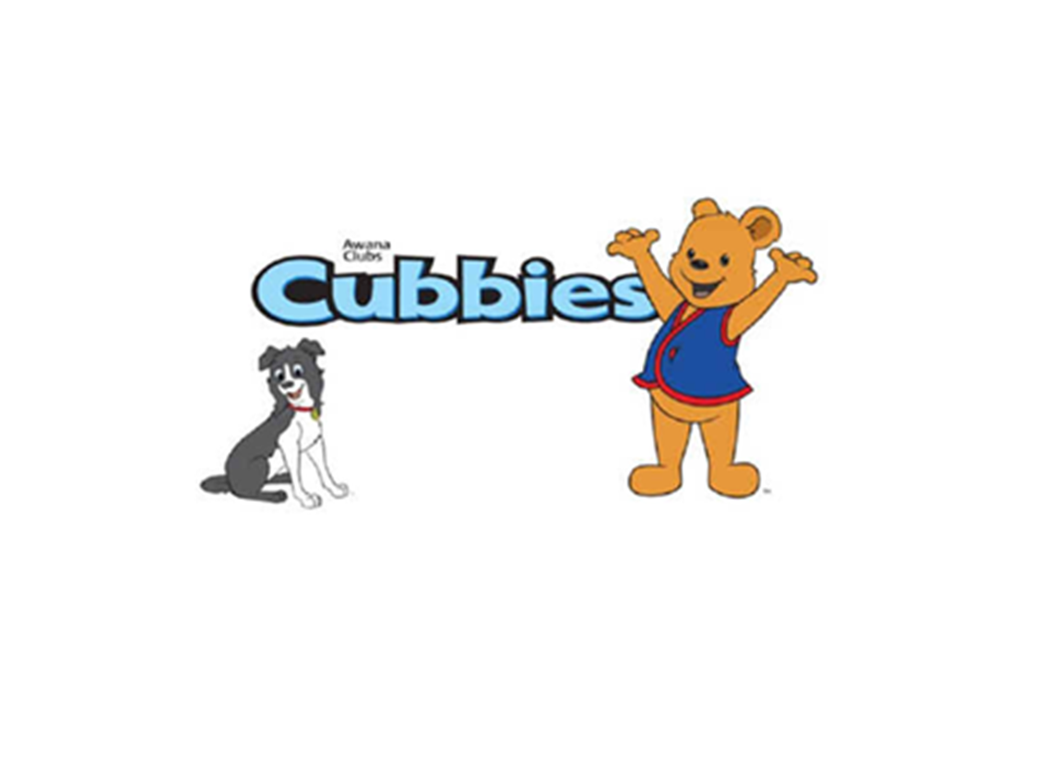

Slide 2

Cubbies Theme Song

Slide 3

Jesus Loves Me

Slide 4
Jesus Loves the Little One

Slide 5
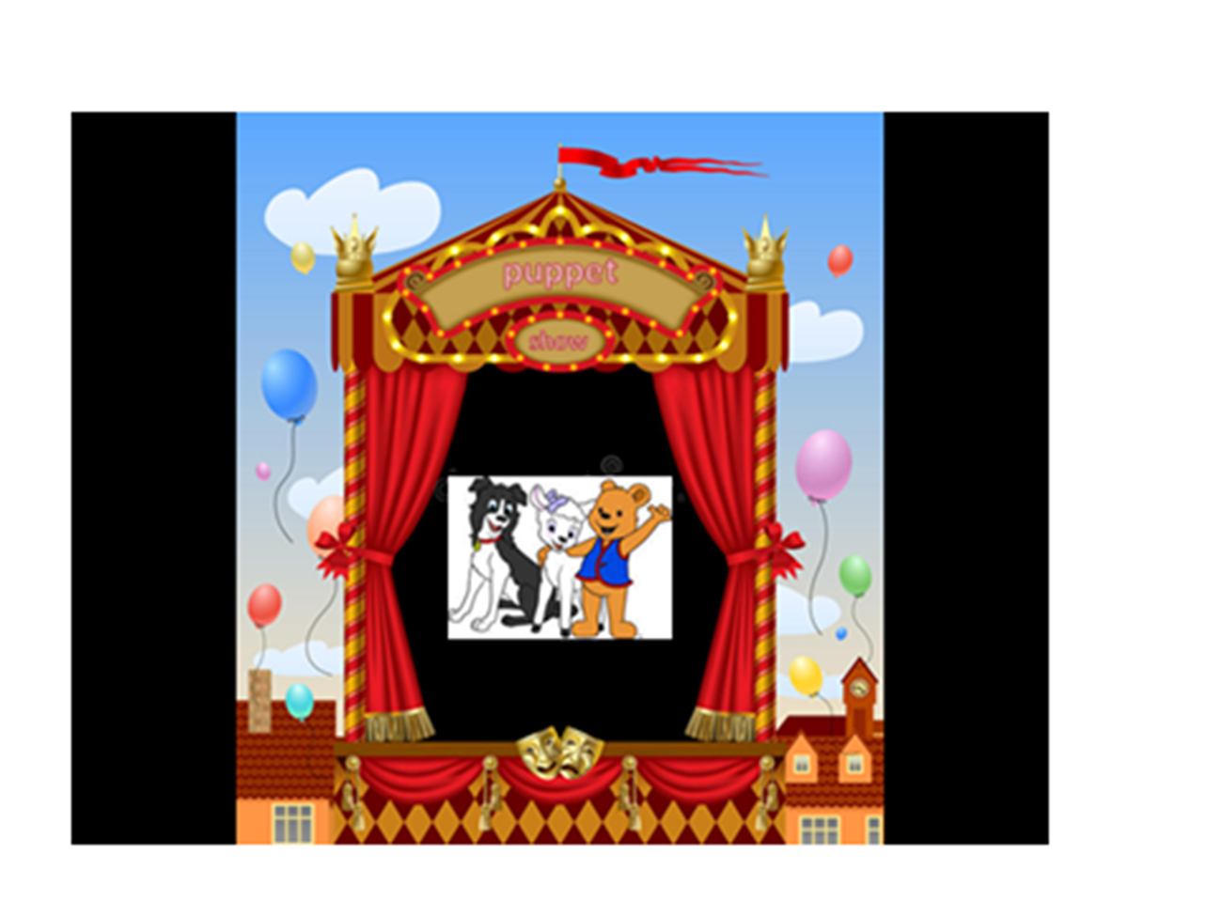

Slide 6
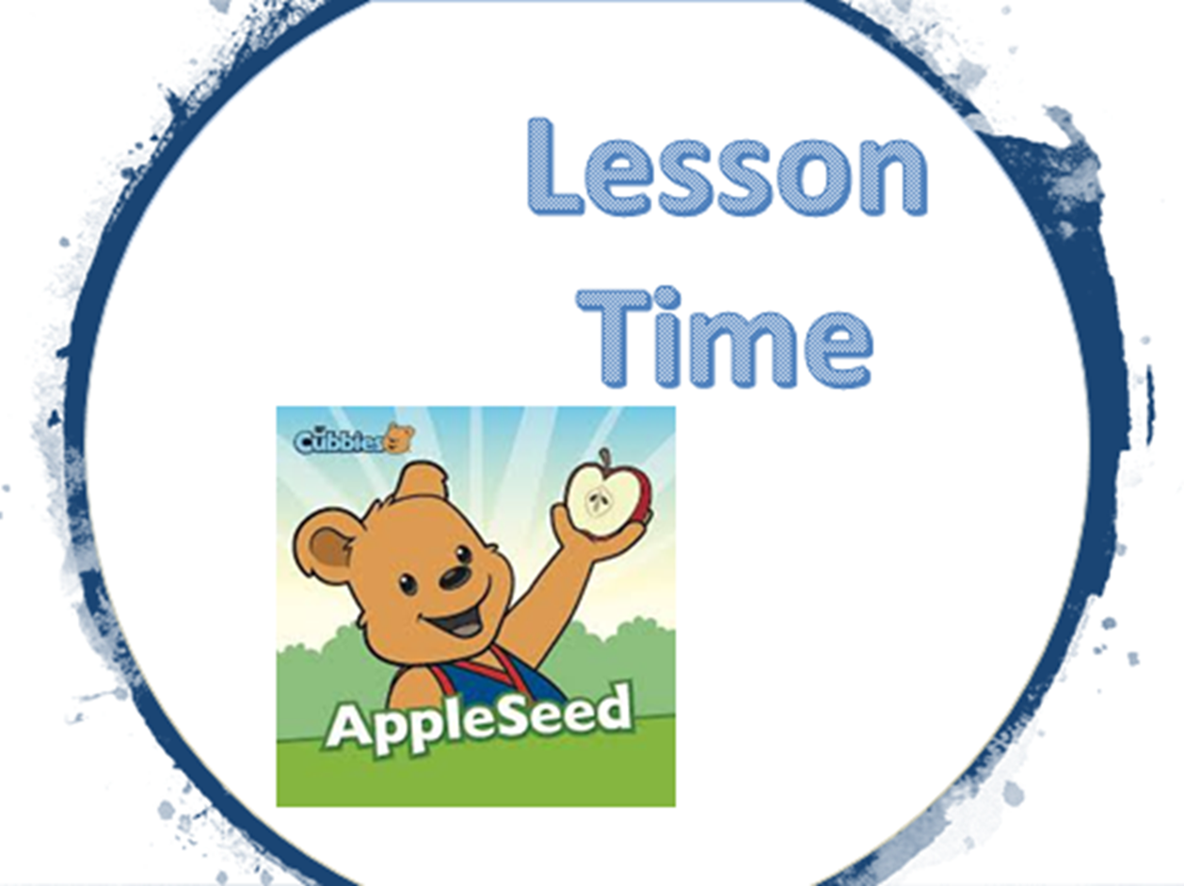

Slide 13


Slide 14
