Slide 1


Slide 2

Jesus Loves Me

Slide 3

The B-I-B-L-E

Slide 4

Jesus Loves the Little One

Slide 5
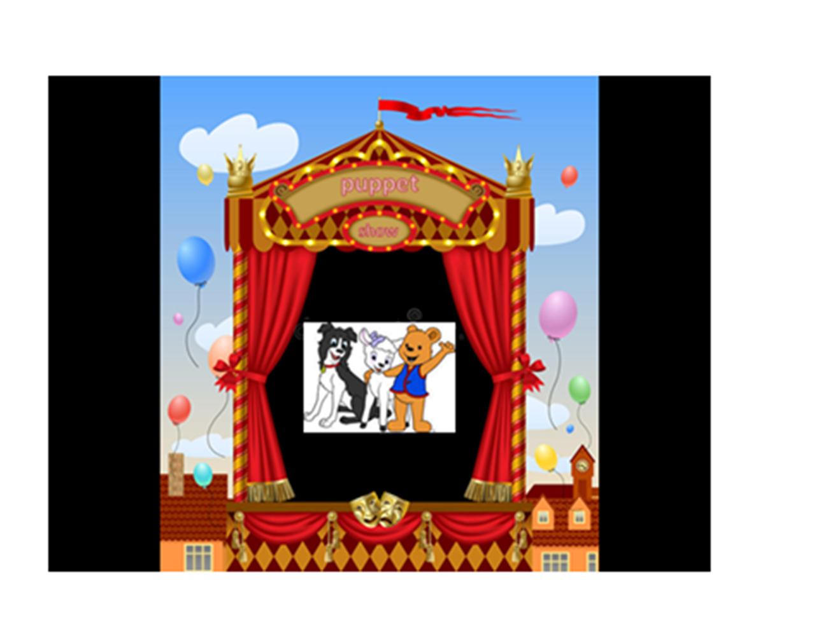

Slide 6
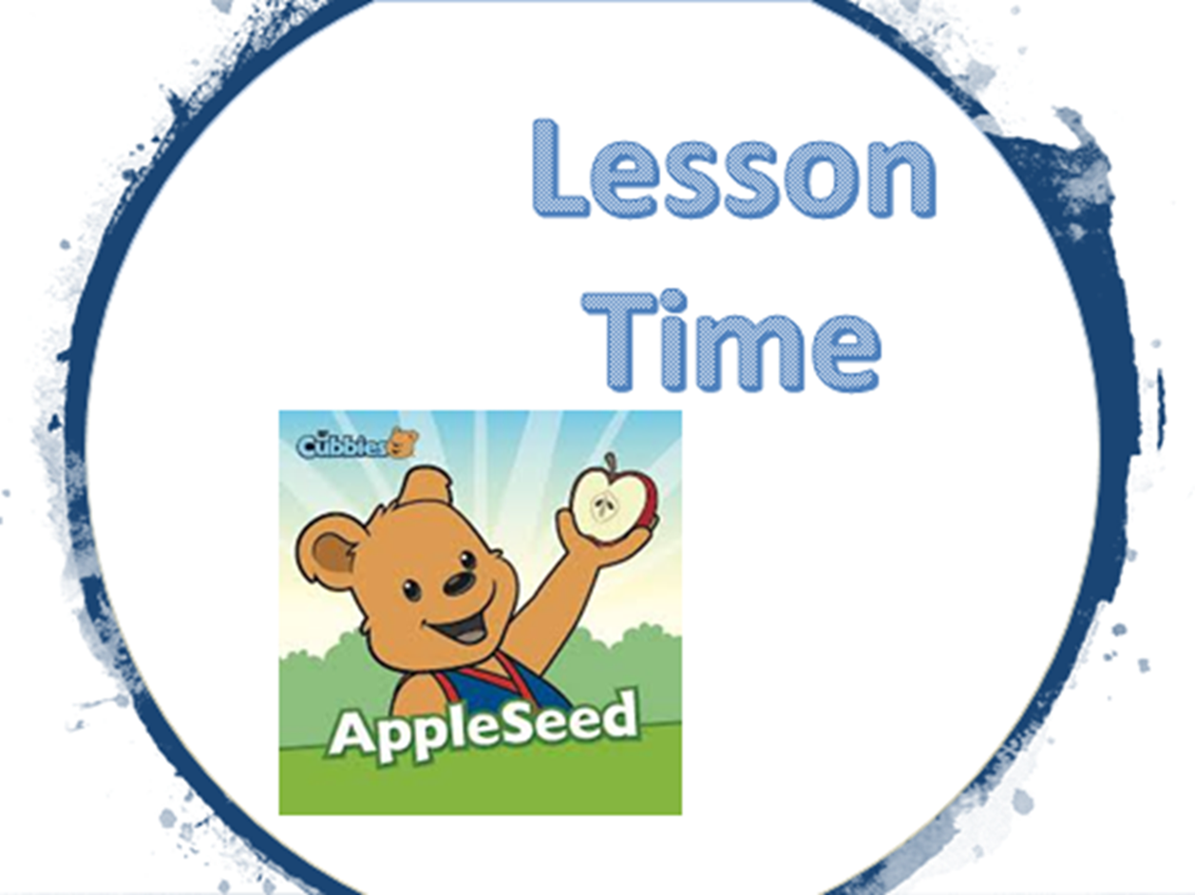

Slide 16


Slide 17


