Slide 1


Slide 2

Cubbies Theme Song

Slide 3
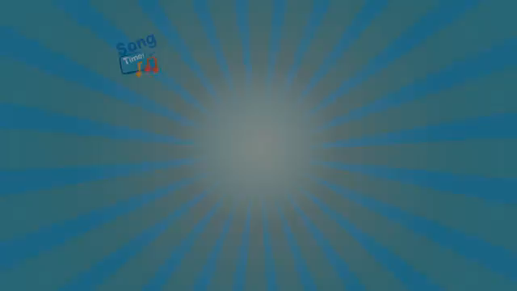
Praise ye the Lord, Hallelujah

Slide 4
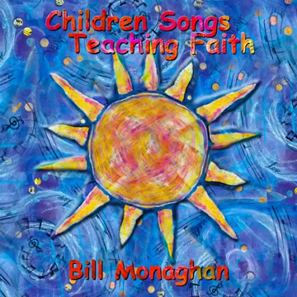
J-E-S-U-S

Slide 5
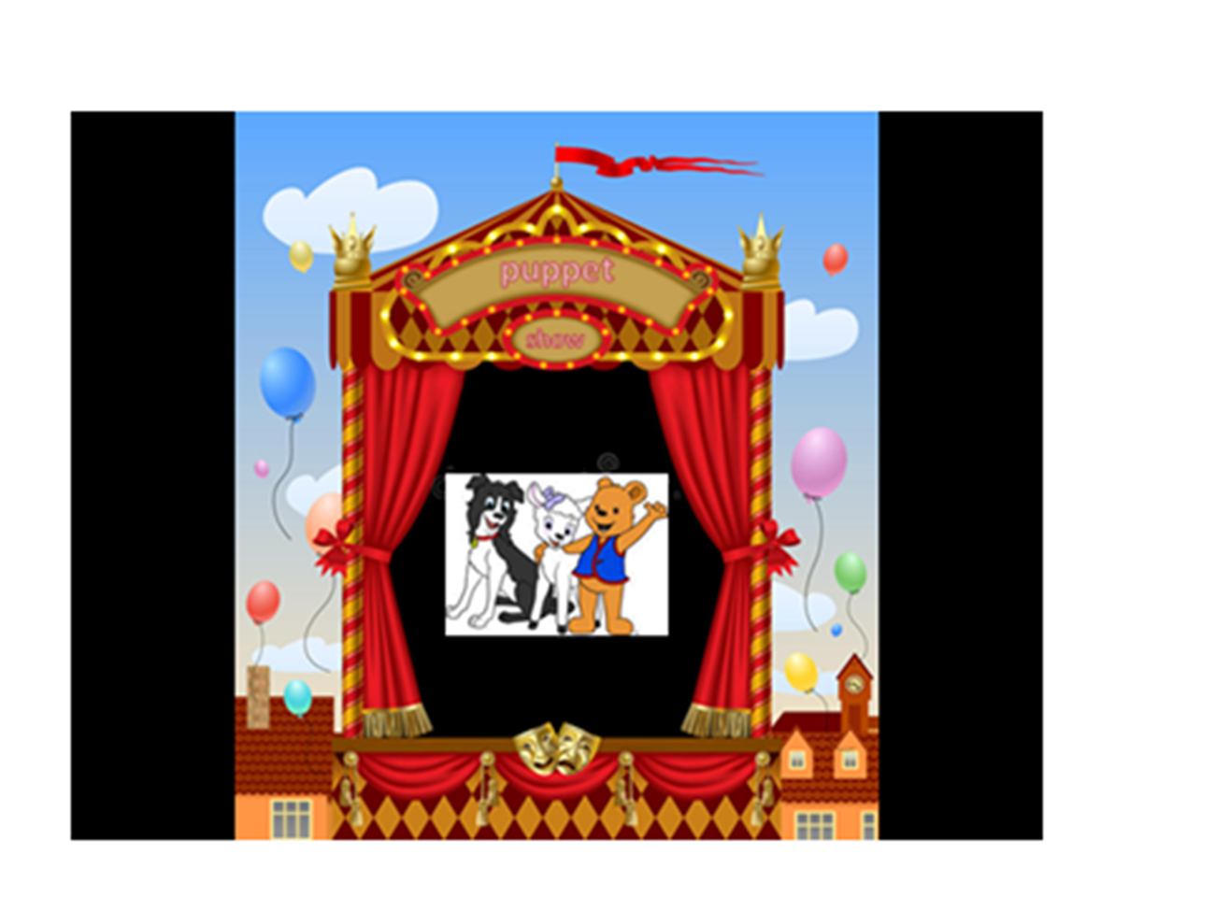

Slide 6
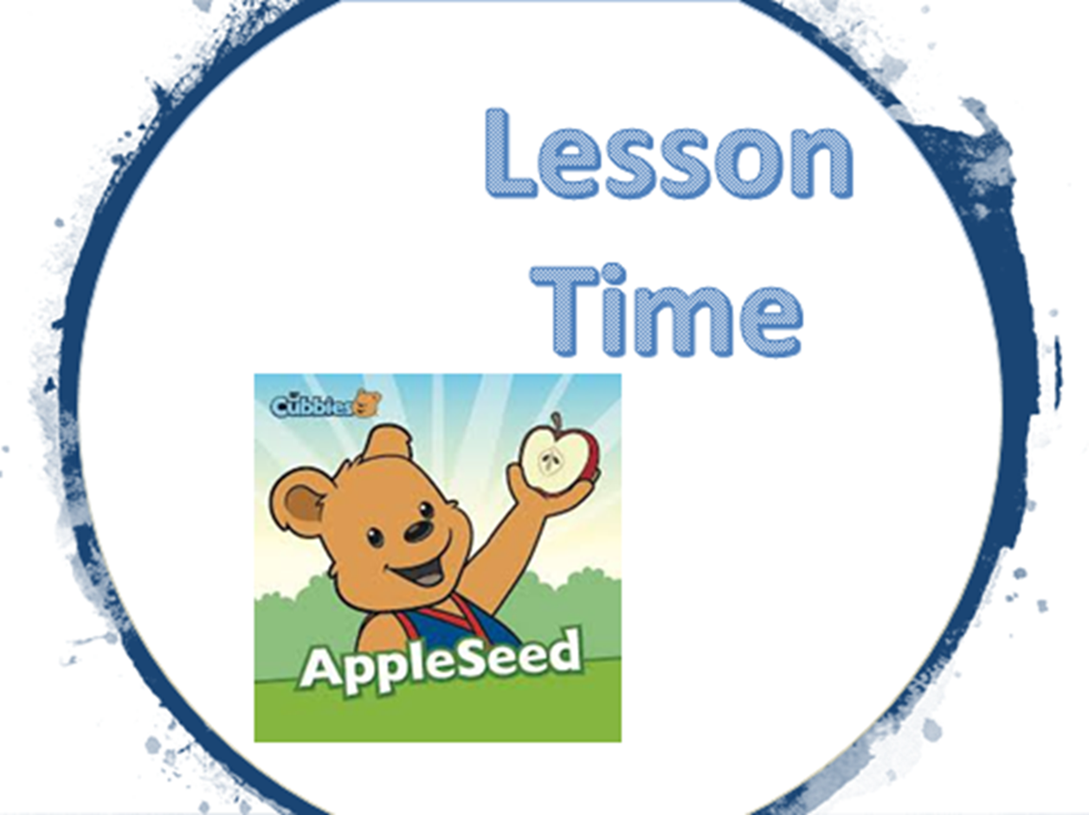

Slide 11
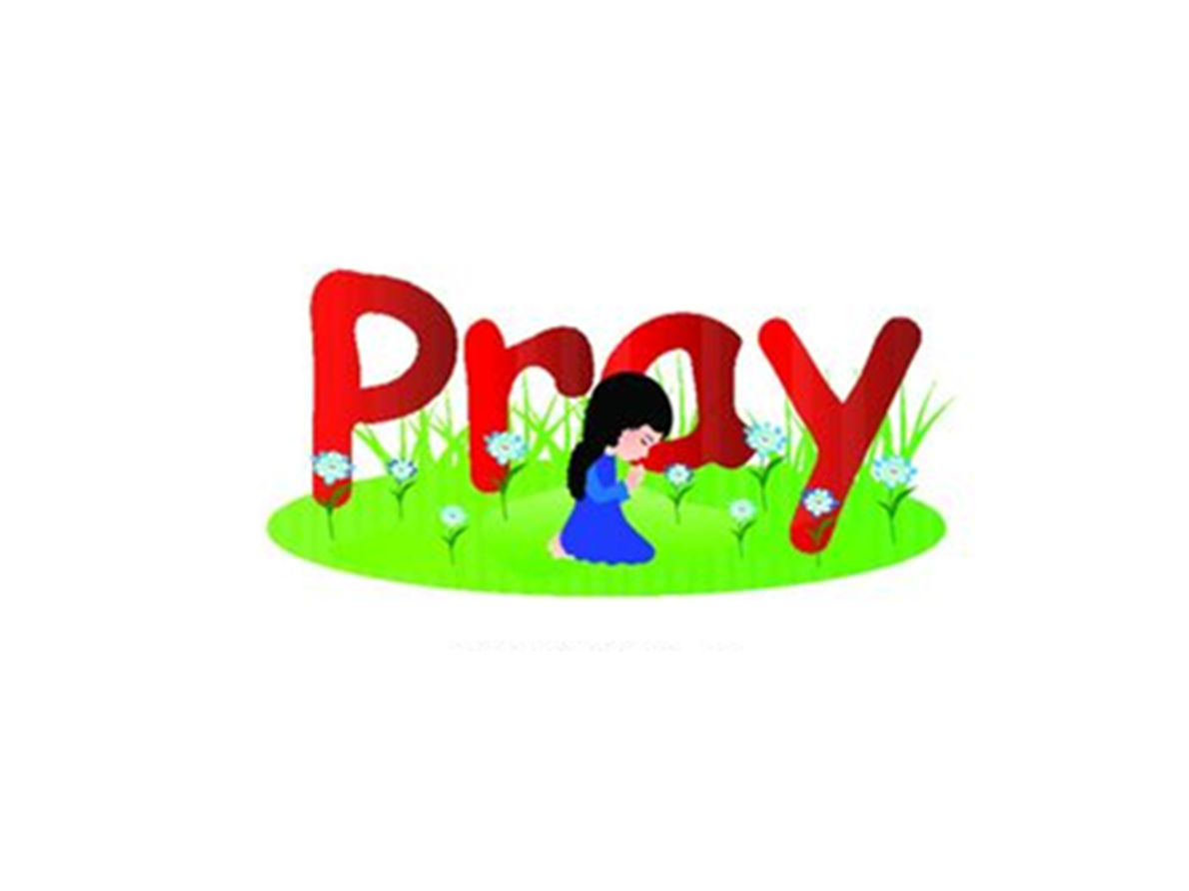

Slide 12
