Slide 1


Slide 2

Cubbies Theme Song

Slide 3

Oh, Be Careful

Slide 4

Zacchaeus

Slide 5
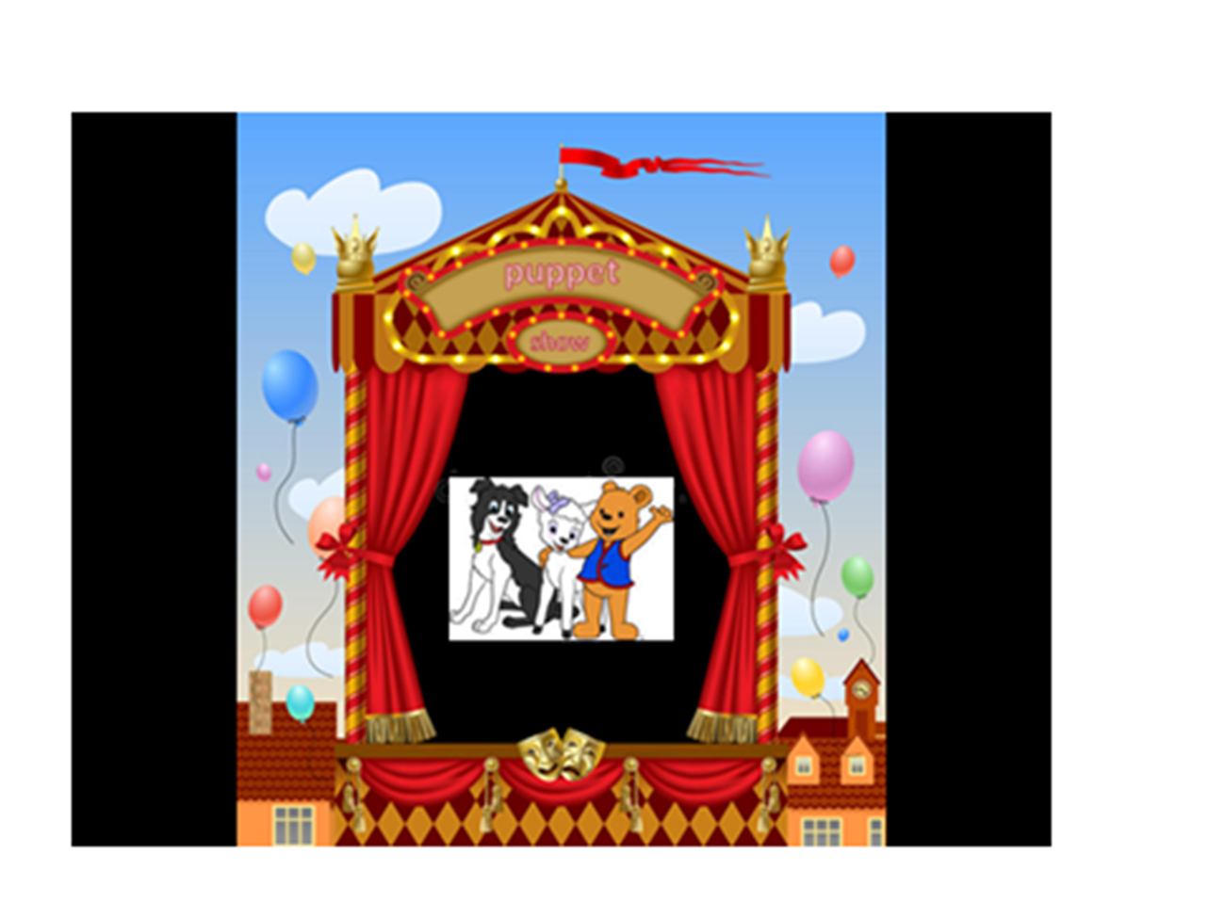

Slide 6
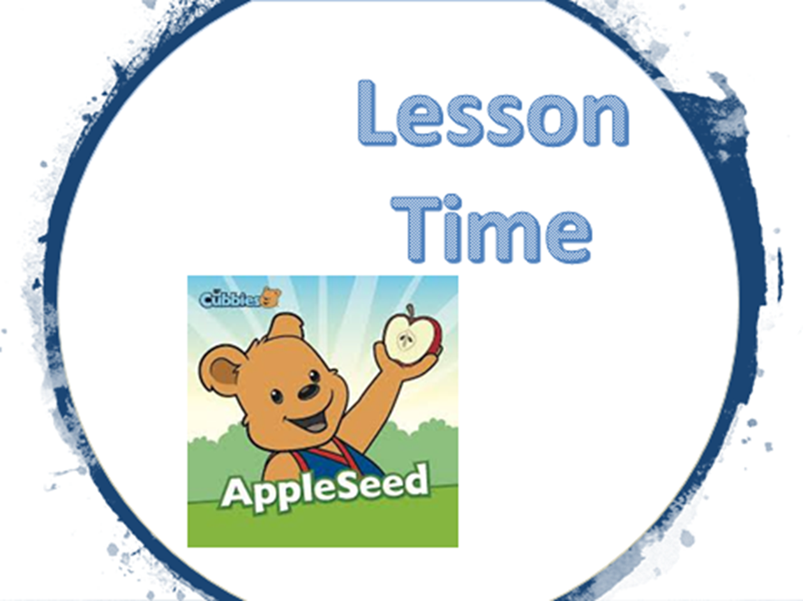

Slide 11


Slide 12
