Slide 1


Slide 2

Cubbies Theme Song

Slide 3

Let It Shine

Slide 4

J-E-S-U-S

Slide 5

Go, Tell the Good News

Slide 6
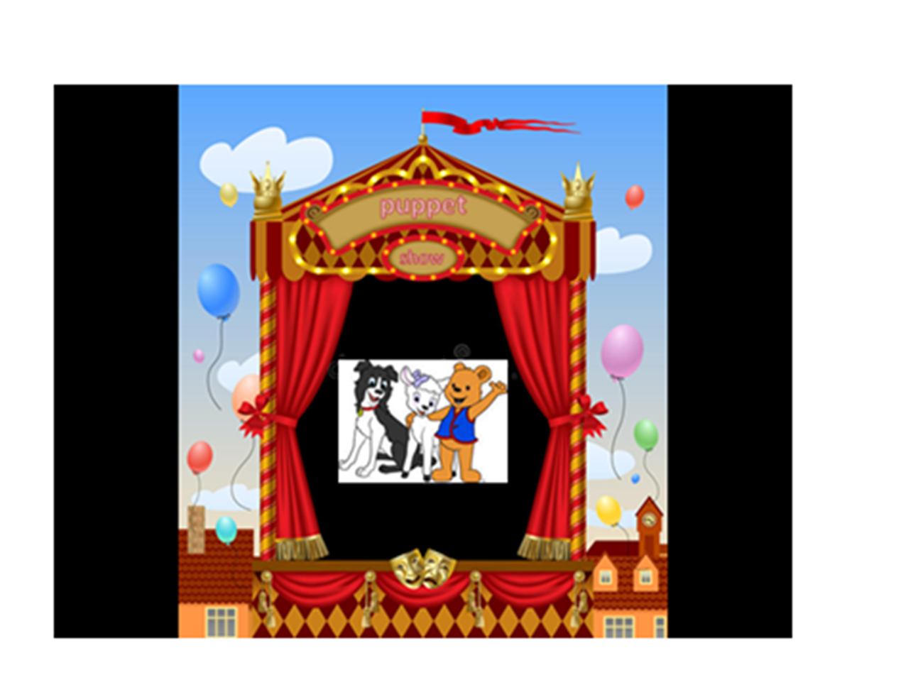

Slide 7
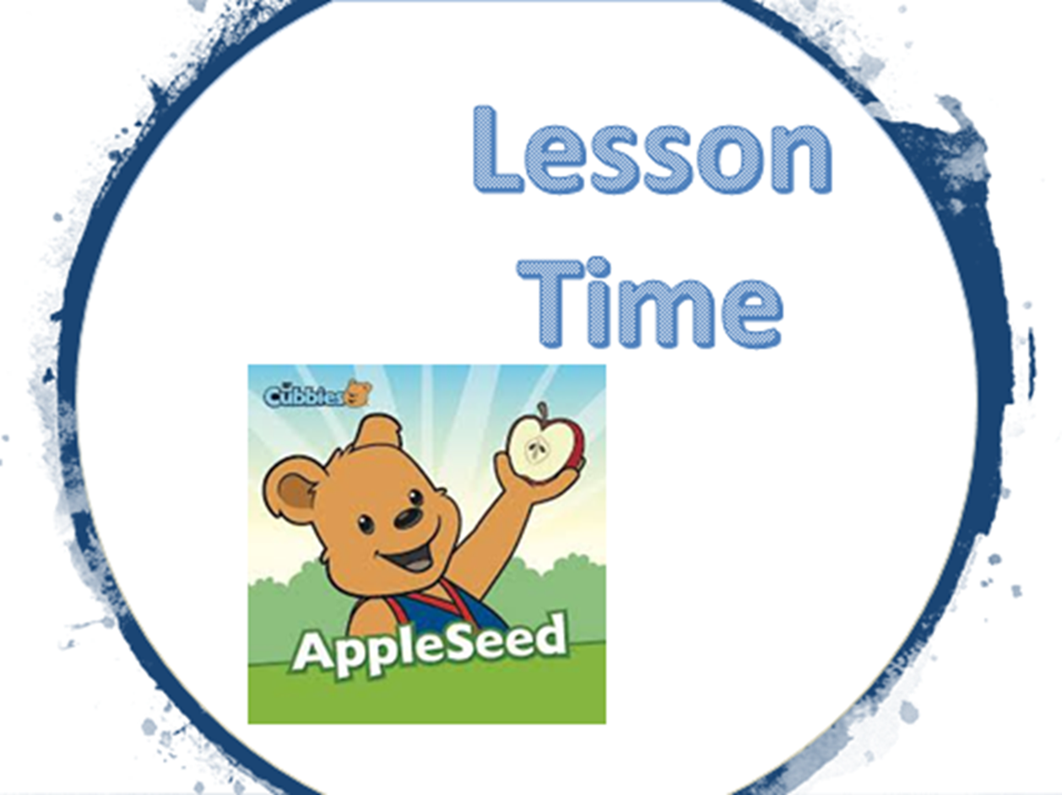

Slide 11


Slide 12


