Slide 1


Slide 2

Cubbies Theme Song

Slide 3

Let It Shine

Slide 4

Go, Tell the Good News

Slide 5
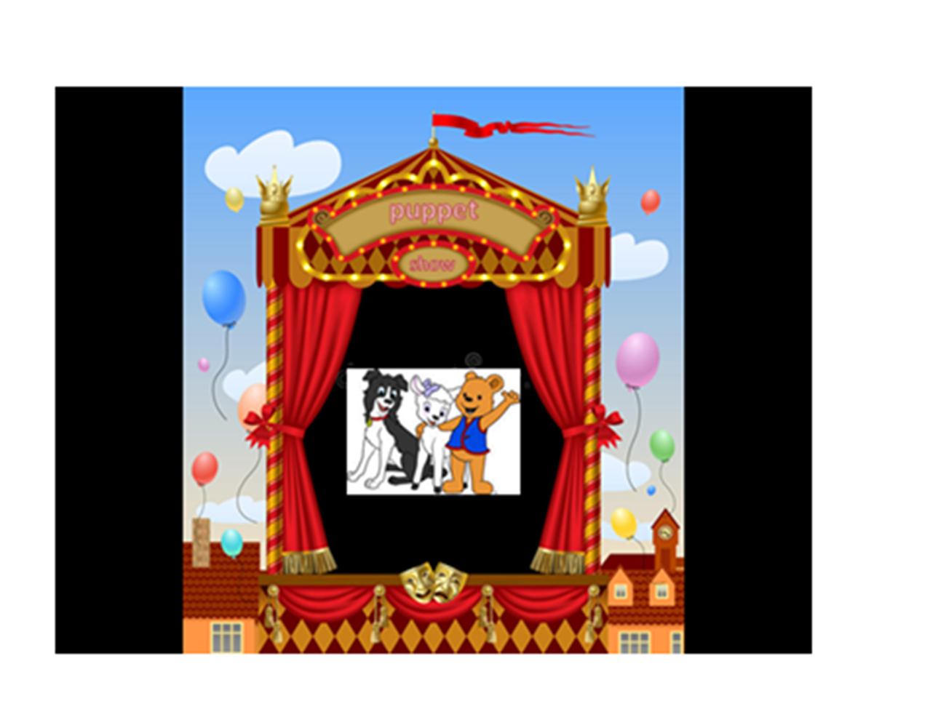

Slide 6
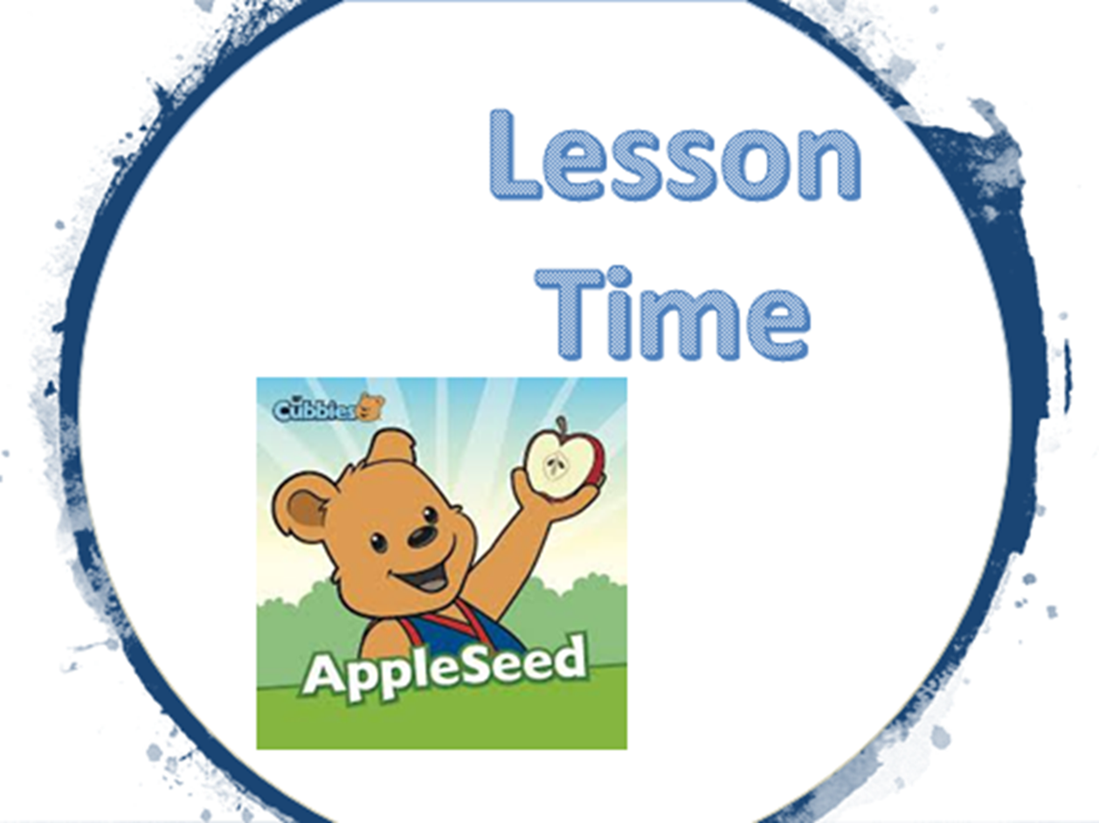

Slide 12


Slide 13


