Slide 1


Slide 2

Cubbies Theme Song

Slide 3

Let It Shine

Slide 4

Go, Tell the Good News

Slide 5

Praise Him, Praise Him All the Little Children

Slide 6

I’ve Got the Joy

Slide 7
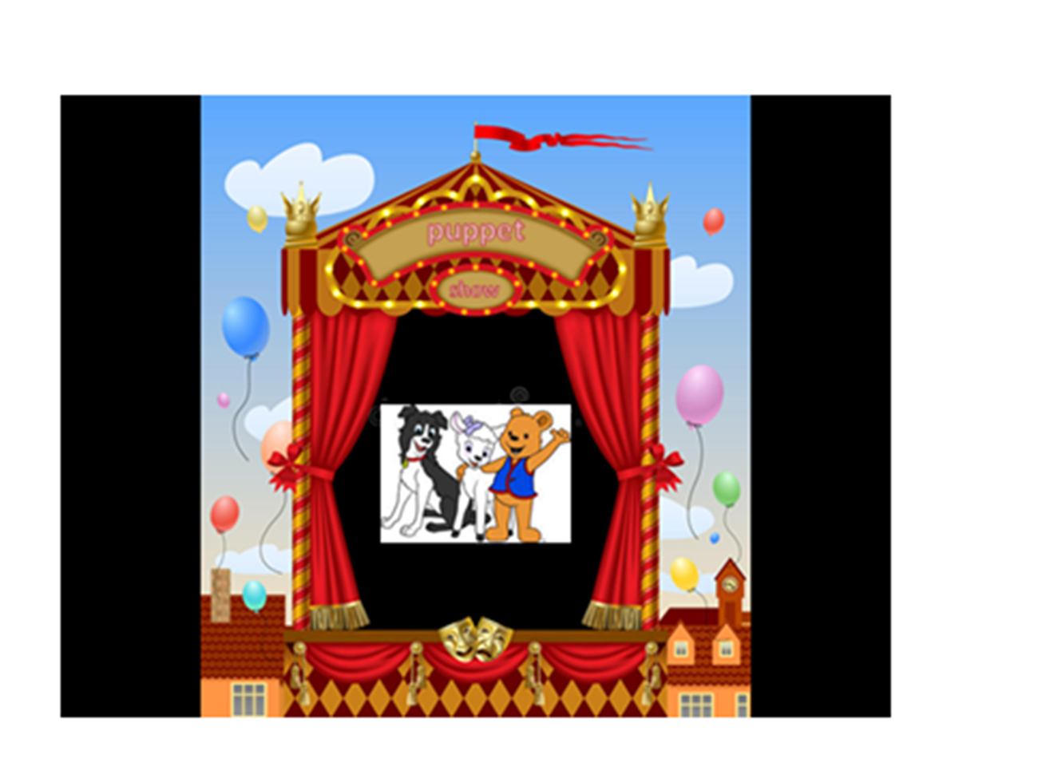

Slide 8
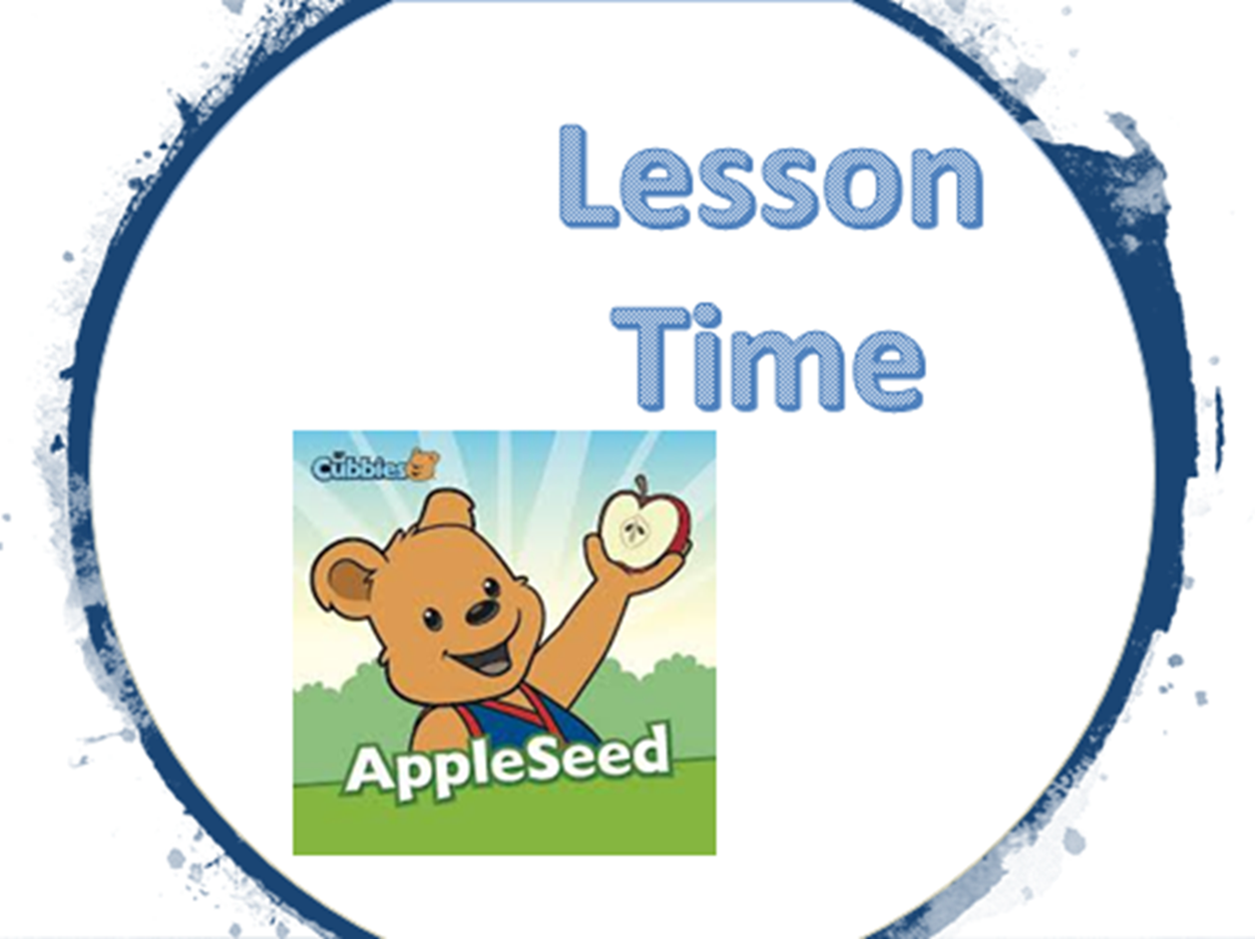

Slide 14


Slide 15


