Slide 1


Slide 2

Cubbies Theme Song

Slide 3

Jesus Loves Me

Slide 4

Go, Tell the Good News

Slide 5
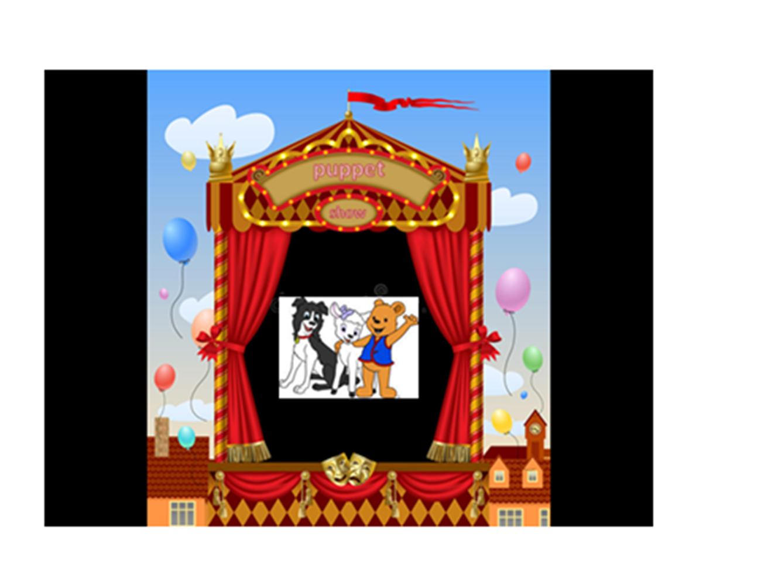

Slide 6
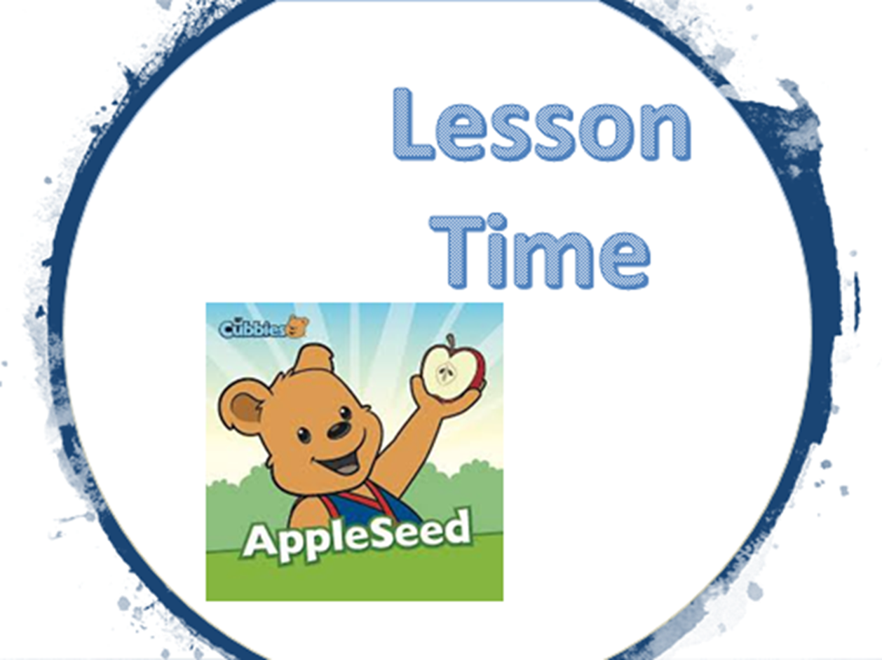

Slide 14


Slide 15


