Slide 1


Slide 2
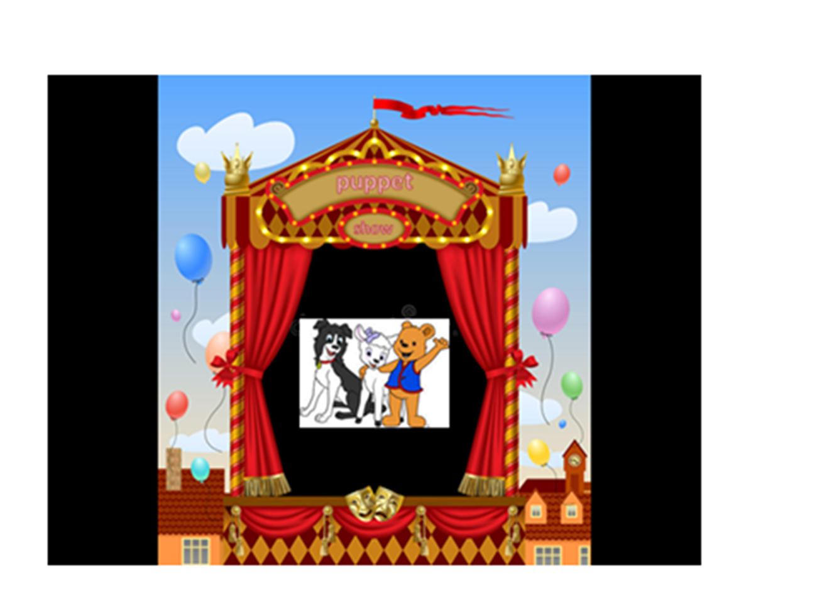

Slide 3

Cubbies Theme Song

Slide 4
J-E-S-U-S (Christmas)

Slide 5
Joy to the World

Slide 6

Away in a Manger

Slide 7
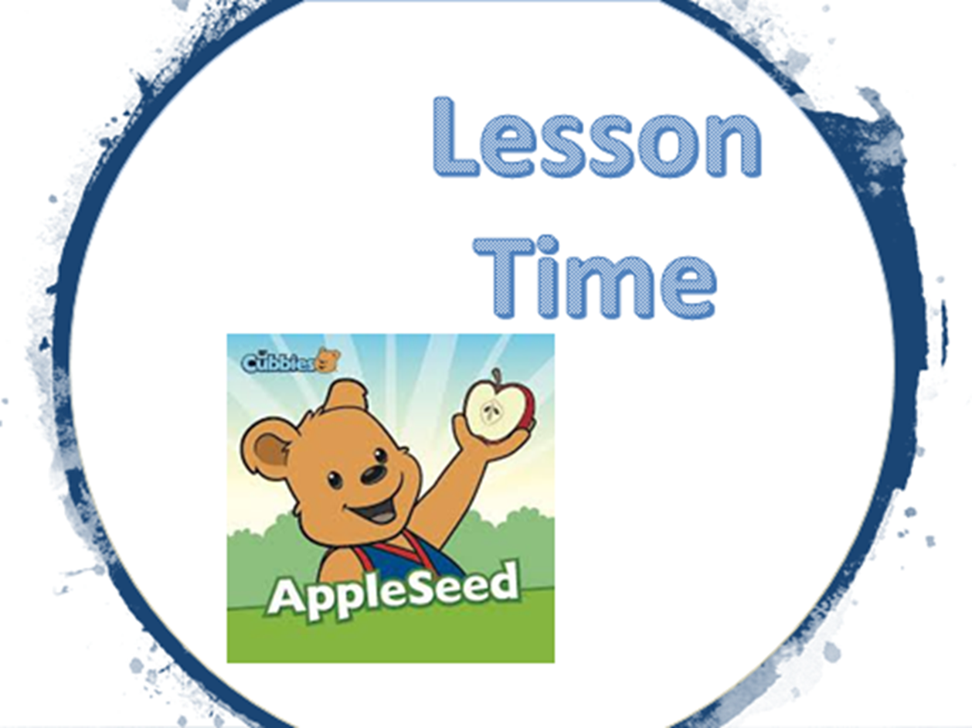

Slide 13


Slide 14
