Slide 1


Slide 2

Cubbies Theme Song

Slide 3

Give Thanks

Slide 4
Praise ye the Lord, Hallelujah

Slide 5
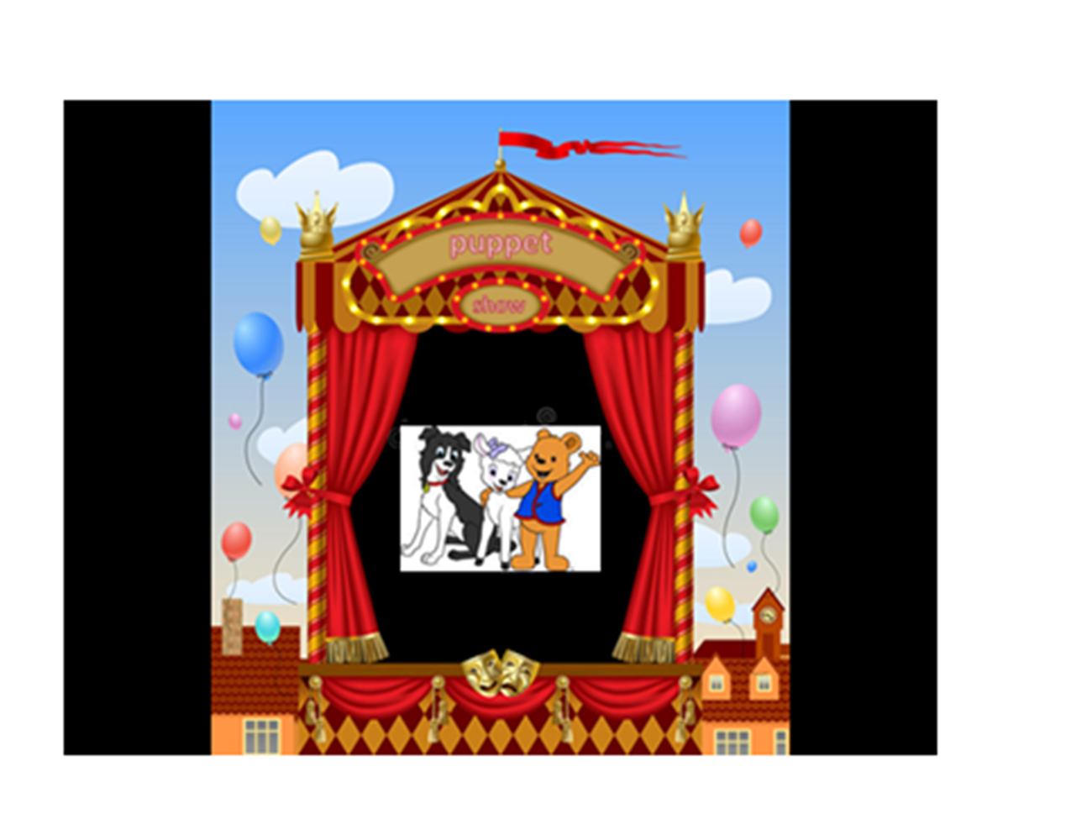

Slide 6
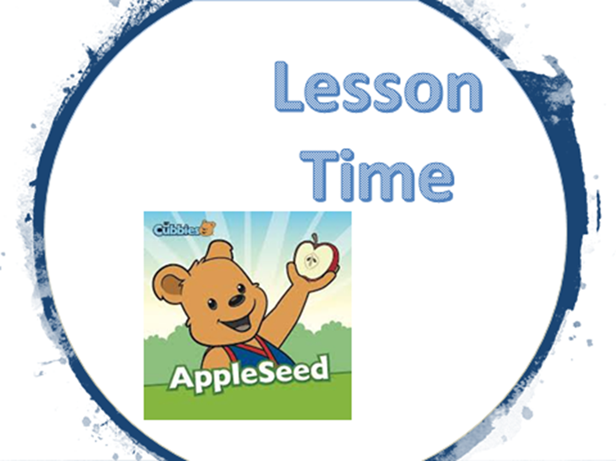

Slide 17
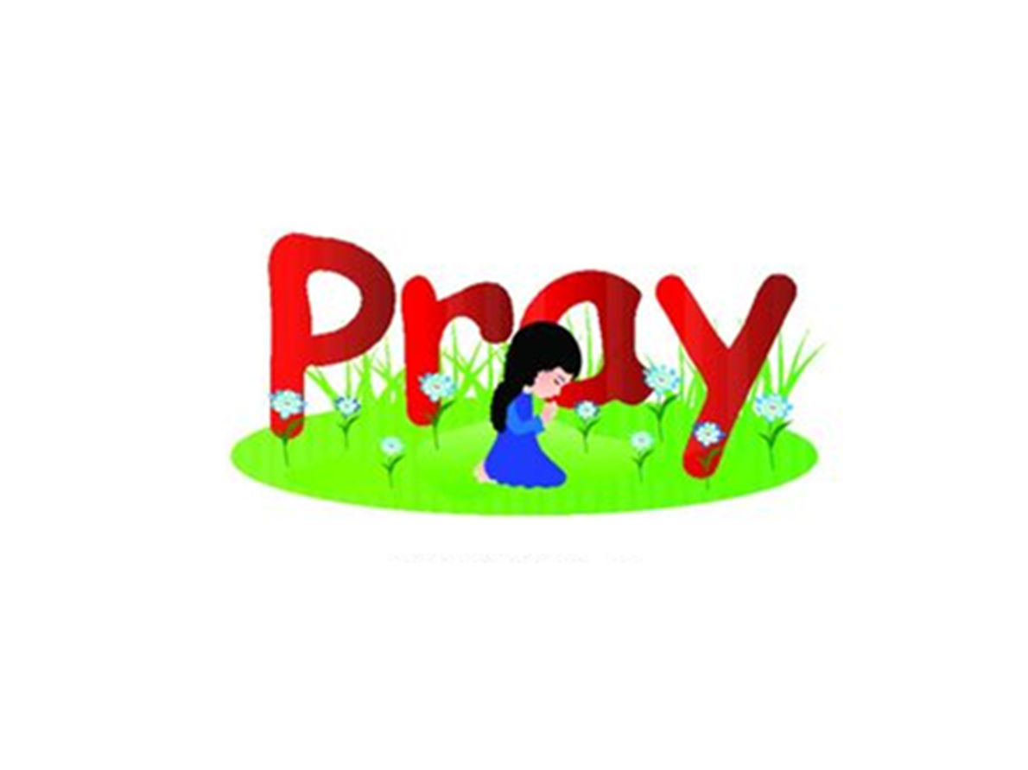

Slide 18
