Slide 1


Slide 2

Cubbies Theme Song

Slide 3

Jesus Loves Me

Slide 4

O How I Love Jesus

Slide 5
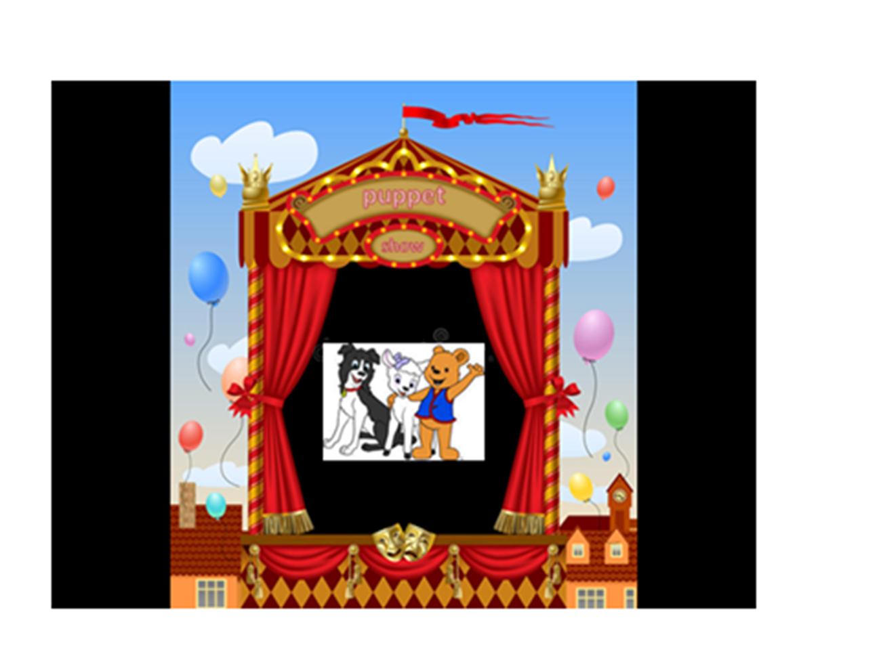

Slide 6
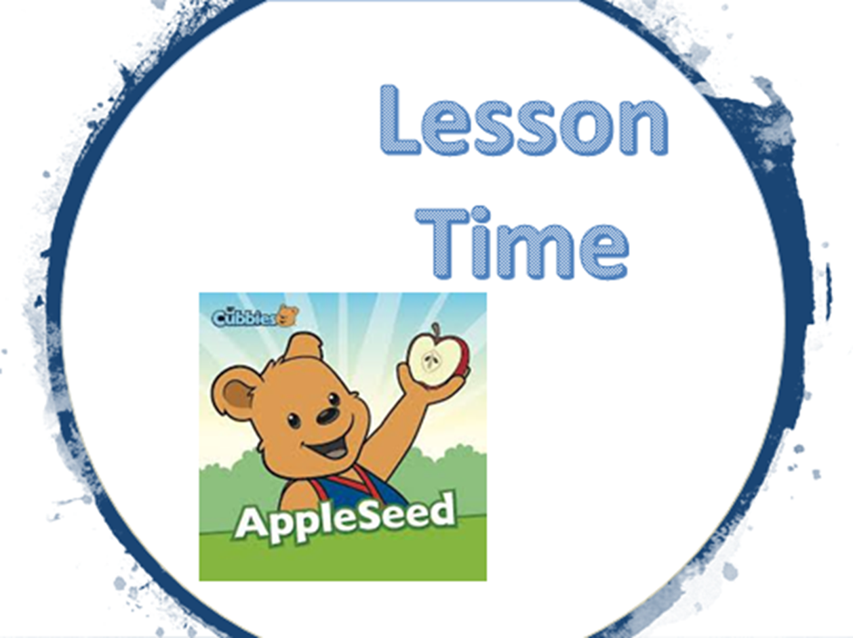

Slide 12


Slide 13


