Slide 1
Giving god the yeah, but…
Exodus 4:10-17

Slide 2
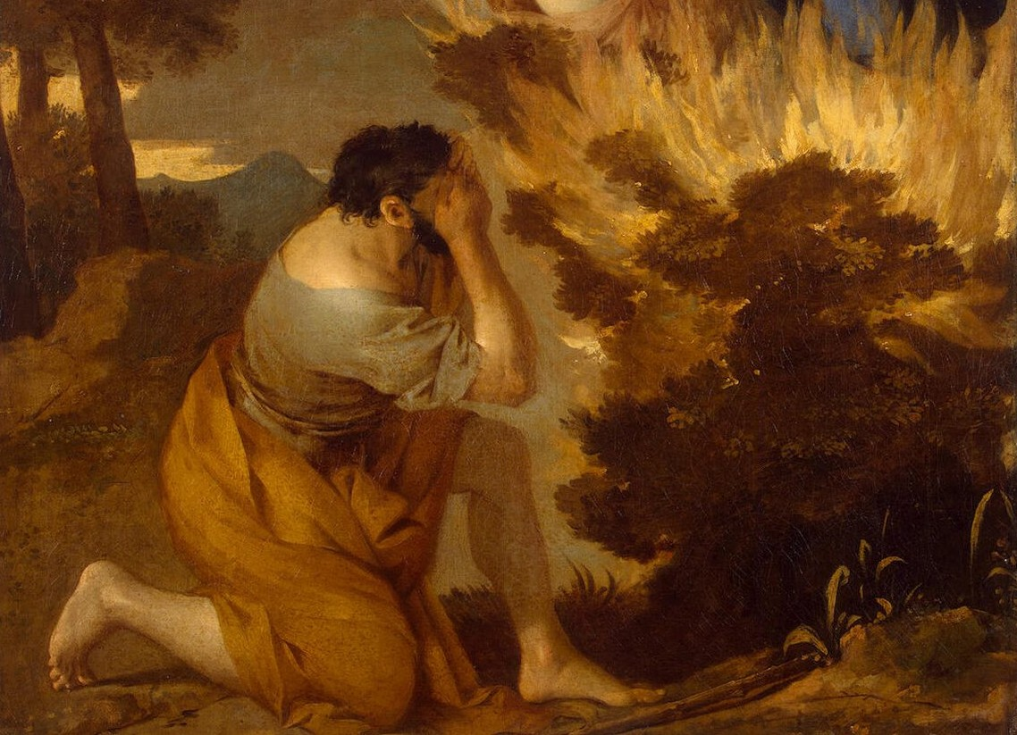

Slide 3
Excuses, excuses
Who Am I
I Don’t Know Your Name
They Won’t Believe Me
I’m Not Good With Words
GOD I DON’T WANT TO DO IT!

Slide 4
Answers and more answers
Who Am I (I Choose You)
I Don’t Know Your Name (I am who I AM Yahweh)
They Won’t Believe Me (Show Them The Signs)
I’m Not Good With Words (I’ll Tell You What to Say)
GOD I DON’T WANT TO DO IT! (I’ll Give You Help But You Still Have to do It)

Slide 5
Our excuses when God calls us
Who Am I (I Choose You)
I’m Not Old Enough/Mature Enough
No one Will Listen to Me
I’m Not Good With Words, It’s Not My Gift
I’m Not a Pastor/I’m not Trained for That
I’m Too Busy with Work/School/Family

Slide 6
“For Behold I am with you always, until the very end of the age”

Slide 7
